Slide 1
Suffering:
A Heavenward Lament and
A Confident Victory
Bob LaForge

Slide 2
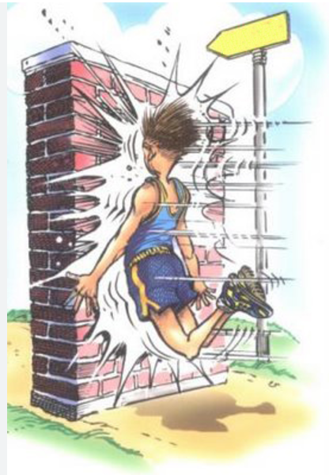
Happiness
Suffering

Slide 3
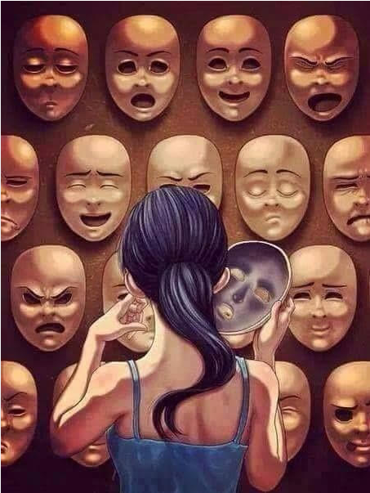
Betrayal
Being cheated
Loneliness
Loss of reputation
Loss of health
Loss of finances
Loss of relationships
Divorce
Abuse
Death
Persecution

Slide 4
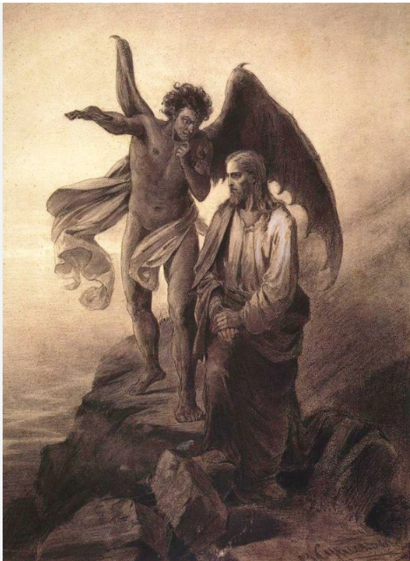
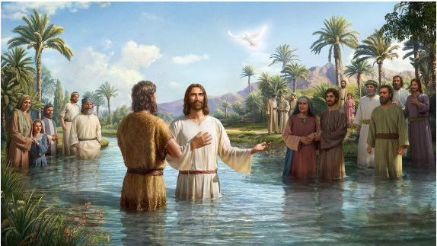

Slide 5
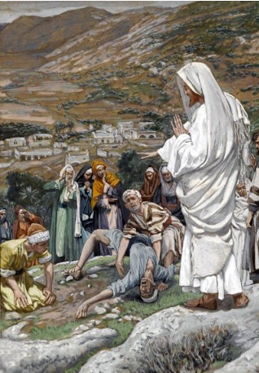
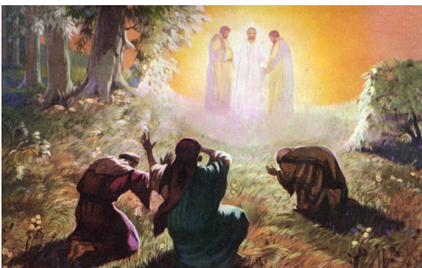

Slide 6
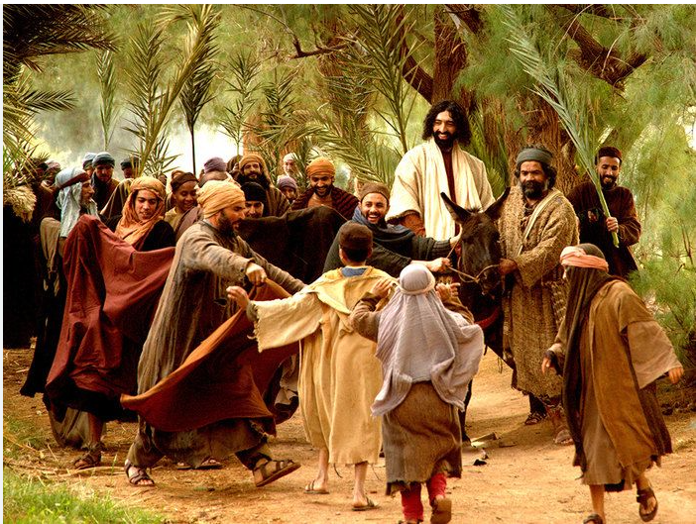
Notes:
https://www.kimaerickson.com/palm-sunday-prophecies/

Slide 7
Revelation 7:9-10
9 After this I looked, and there before me was a great multitude that no one could count, from every nation, tribe, people and language, standing before the throne and before the Lamb. They were wearing white robes and were holding palm branches in their hands.
10 And they cried out in a loud voice:
  “Salvation belongs to our God, who sits on the throne, and to the Lamb.”

Slide 8
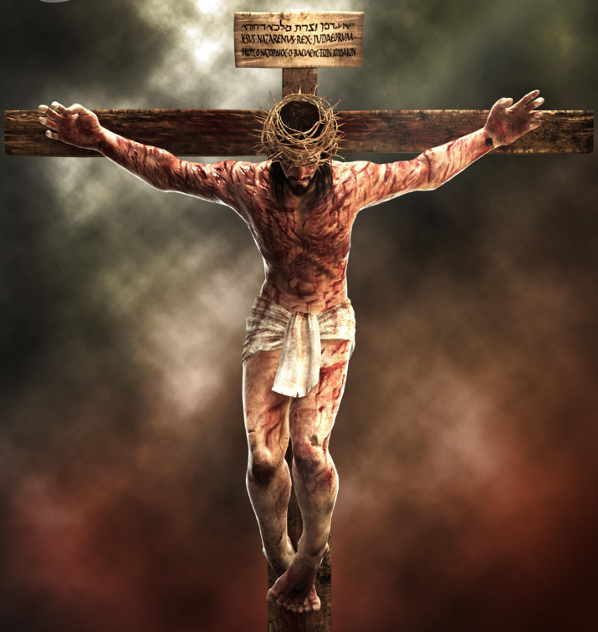
Sunday
Friday

Slide 9
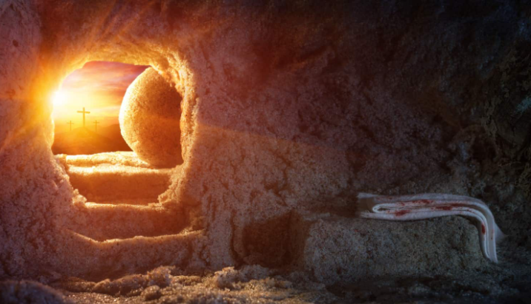

Slide 10
Romans 5:2-4
through whom [Jesus Christ] we also have obtained our introduction by faith into this grace in which we stand; and we celebrate in hope of the glory of God. And not only this, but we also celebrate in our tribulations, knowing that tribulation brings about perseverance; and perseverance, proven character; and proven character, hope;

Slide 11

Hope
Proven Character
Tribulations
Perseverance

Slide 12
Optimism says “Don’t worry, it probably won’t happen.”
Hope says, “It may happen, but God will keep us.”

Slide 13
Song of Solomon 8:5
Who is this coming up from the wilderness, leaning on her beloved?

Slide 14
Our topics
Biblical truths about suffering
Why is there evil and why do we suffer?
What are the sources of suffering
Wrong thinking about suffering both Christian and non-Christian
Suffering gives us two choices
Jesus can relate to our pain because He has experienced it Himself
How should we respond to our own suffering
How should we respond to other people’s suffering
Biblical people who suffered and how they responded
The Book of Lamentations

Slide 15
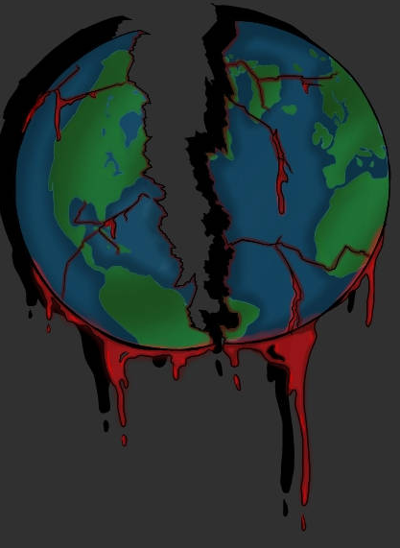
Biblical Truths about Suffering
1) Suffering in the world/universe started with rebellion
Notes:
https://www.deviantart.com/kamanari/art/Our-Broken-World-342968282

Slide 16
Biblical Truths about Suffering
1) Suffering in the world/universe started with rebellion
2) Those who deserve judgment, apart from mercy, will suffer but so will the innocent

Slide 17
Proverbs 11:21
Be assured, the evil person will not go unpunished

Slide 18
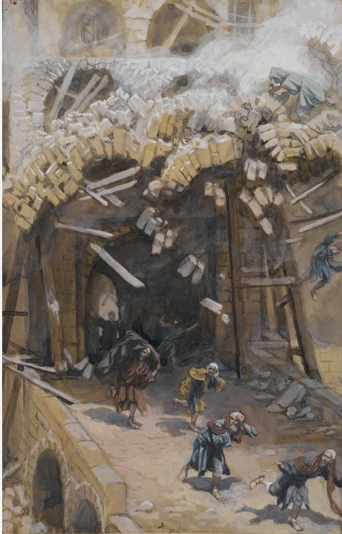
Luke 13:4
Or do you think that those eighteen on whom the tower in Siloam fell and killed them were worse offenders than all the other people who live in Jerusalem?

Slide 19
Biblical Truths about Suffering
1) Suffering in the world/universe started with rebellion
2) Those who deserve judgment, apart from mercy, will suffer but so will the innocent
3) God does whatever He pleases

Slide 20
Isaiah 46:9-10
9 Remember the former things long past,
For I am God, and there is no other;
I am God, and there is no one like Me,
10 Declaring the end from the beginning,
And from ancient times things which have not been done,
Saying, ‘My plan will be established,
And I will accomplish all My good pleasure’

Slide 21
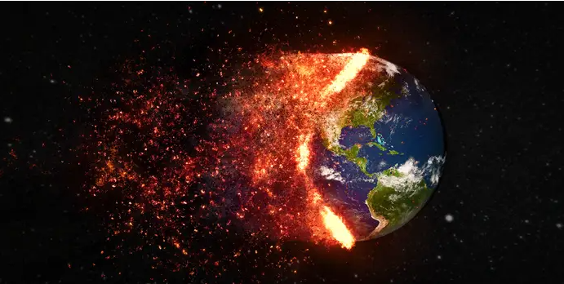
Job 34:14-15
14 If He were to determine to do so,
If He were to gather His spirit and His breath to Himself,
15 Humanity would perish together,
And mankind would return to dust.

Slide 22
Psalm 115:3
But our God is in the heavens; He does whatever He pleases.

Slide 23
Biblical Truths about Suffering
1) Suffering in the world/universe started with rebellion
2) Those who deserve judgment, apart from mercy, will suffer but so will the innocent
3) God does whatever He pleases
4) God is aware of our personal suffering and He cares

Slide 24
Exodus 1:14
all their labors which they violently had them perform as slaves.
Exodus 4:31
So the people believed; and when they heard that the Lord was concerned about the sons of Israel and that He had seen their affliction, they bowed low and worshiped.
Psalm 13:1
How long, Lord? Will You forget me forever? How long will You hide Your face from me?

Slide 25
God made a promise (this is implied)
Exodus 4:31
So the people believed; and when they heard that the Lord was concerned about the sons of Israel and that He had seen their affliction, they bowed low and worshiped.
The people believed
They knew that God was concerned
God had seen their affliction
They bowed low and worshipped

Slide 26
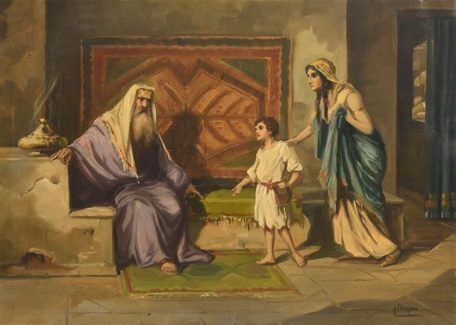
1 Samuel 2: 12
Now the sons of Eli were useless men; they did not know the Lord.
Notes:
https://papyrus.greenville.edu/2020/10/gods-calling-a-story-of-samuel/

Slide 27
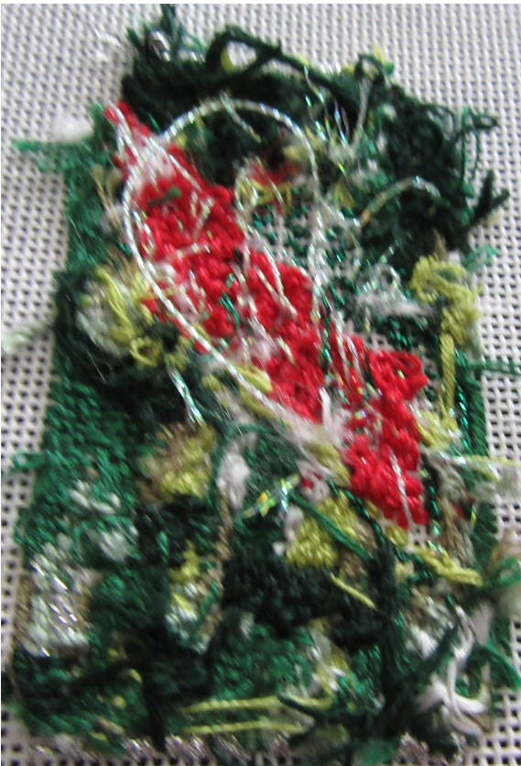
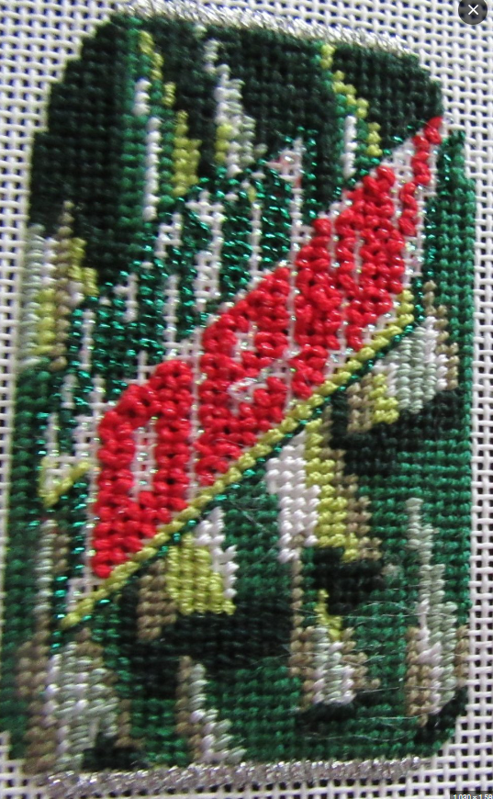

Slide 28
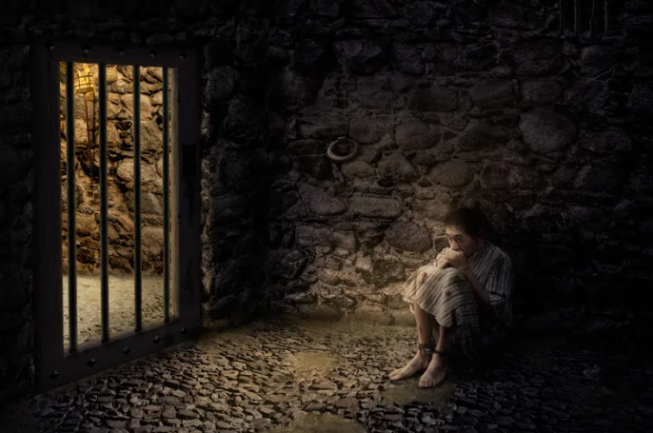
Psalm 102:19-20
19 For He [God] looked down from His holy height; from heaven the Lord looked upon the earth,
20 To hear the groaning of the prisoner, to set free those who were doomed to death,

Slide 29
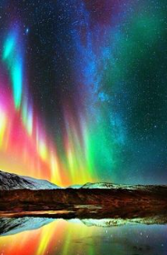


Slide 30
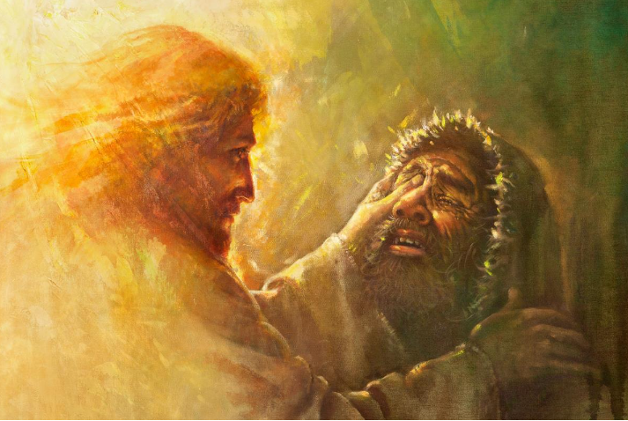

Slide 31
Biblical Truths about Suffering
1) Suffering in the world/universe started with rebellion
2) Those who deserve judgment, apart from mercy, will suffer but so will the innocent
3) God does whatever He pleases
4) God is aware of our personal suffering and He cares
5) God is our only true and final relief from suffering both now and in the future

Slide 32
1 Corinthians 15:55-57
55 Where, O Death, is your victory? Where, O Death, is your sting?” 56 The sting of death is sin, and the power of sin is the Law;
57 but thanks be to God, who gives us the victory through our Lord Jesus Christ.
58 Therefore, my beloved brothers and sisters, be firm, immovable, always excelling in the work of the Lord, knowing that your labor is not in vain in the Lord.

Slide 33
Hebrews 7:24-25
24 Jesus, on the other hand, because He continues forever, holds His priesthood permanently. 25 Therefore He is also able to save forever those who come to God through Him, since He always lives to make intercession for them.

Slide 34
Biblical Truths about Suffering
1) Suffering in the world/universe started with rebellion
2) Those who deserve judgment, apart from mercy, will suffer but so will the innocent
3) God does whatever He pleases
4) God is aware of our personal suffering and He cares
5) God is our only true and final relief from suffering both now and in the future
6) Suffering and relief can be used by God to bring people to Himself

Slide 35
John 12:9-12
9 The large crowd of the Jews then learned that He was there; and they came, not on account of Jesus only, but so that they might also see Lazarus, whom He raised from the dead. 10 But the chief priests planned to put Lazarus to death also, 11 because on account of him many of the Jews were going away and were believing in Jesus.

Slide 36
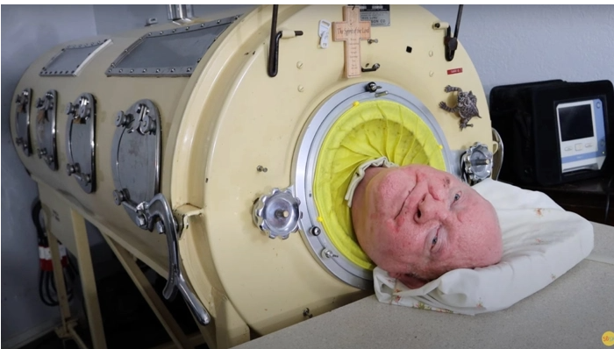

Slide 37
Why is there evil and why do we suffer?
Satan and the angels
Mankind starting with Adam and Eve

Slide 38
Why is there evil and why do we suffer?
Satan and the angels

Slide 39
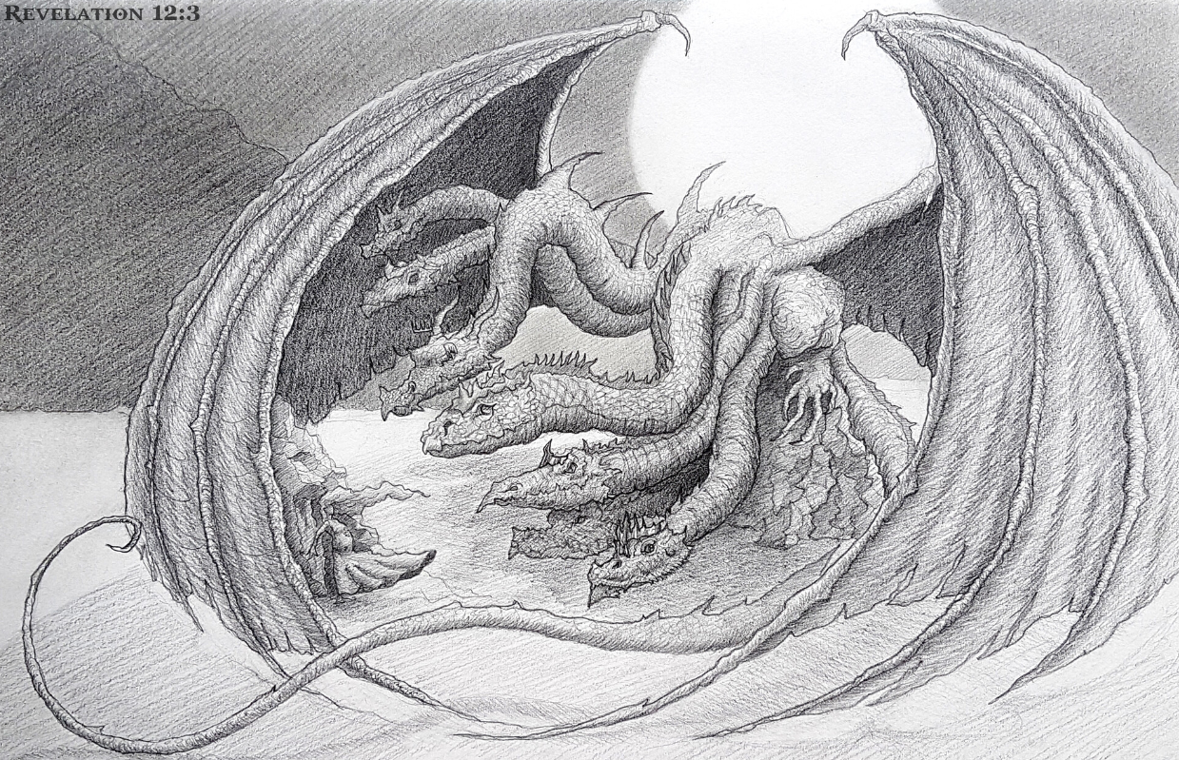
Revelation 12:3-4b
3 Then another sign appeared in heaven: and behold, a great red dragon having seven heads and ten horns, and on his heads were seven crowns. 4 And his tail swept away a third of the stars of heaven and hurled them to the earth.
Notes:
https://oliver-kriel.artstation.com/projects/18a9Q8

Slide 40
Demons possess people.
Matthew 8:16, “Now when evening came, they brought to Him many who were demon-possessed; and He cast out the spirits with a word, and healed all who were ill.”
Demons deceive with false doctrine.
1 Timothy 4:1, “But the Spirit explicitly says that in later times some will fall away from the faith, paying attention to deceitful spirits and teachings of demons…”
Demons perform wicked signs to gain followers.
Revelation 16:14, “for they are spirits of demons, performing signs, which go out to the kings of the entire world, to gather them together for the war of the great day of God, the Almighty.”

Slide 41
2 Peter 2:4
For if God did not spare angels when they sinned, but cast them into hell and committed them to pits of darkness, held for judgment…
Jude 6
And angels who did not keep their own domain but abandoned their proper dwelling place, these He has kept in eternal restraints under darkness for the judgment of the great day…

Slide 42
Ezekiel 28:12b-17
“You [Satan] had the seal of perfection,
Full of wisdom and perfect in beauty.
13 You were in Eden, the garden of God;
Every precious stone was your covering:
The ruby, the topaz and the diamond;
The beryl, the onyx and the jasper;
The lapis lazuli, the turquoise and the emerald;
And the gold, the workmanship of your settings and sockets, was in you.
On the day that you were created they were prepared.
14 You were the anointed cherub who covers,

Slide 43
And I placed you there.
You were on the holy mountain of God;
You walked in the midst of the stones of fire.
15 You were blameless in your ways
From the day you were created
Until unrighteousness was found in you.

Slide 44
16 By the abundance of your trade
You were internally filled with violence,
And you sinned;
Therefore I have cast you as profane
From the mountain of God.
And I have destroyed you, you covering cherub,
From the midst of the stones of fire.
17 Your heart was haughty because of your beauty;
You corrupted your wisdom by reason of your splendor.

Slide 45
Jeremiah 9:23-24
23 This is what the Lord says: “Let no wise man boast of his wisdom, nor let the mighty man boast of his might, nor a rich man boast of his riches; 24 but let the one who boasts boast of this, that he understands and knows Me, that I am the Lord who exercises mercy, justice, and righteousness on the earth; for I delight in these things,” declares the Lord.

Slide 46
Habakkuk 3:17-19
¹⁷ Though the fig tree should not blossom
And there be no fruit on the vines,
Though the yield of the olive should fail
And the fields produce no food,
Though the flock should be cut off from the fold
And there be no cattle in the stalls,
¹⁸ Yet I will exult in the Lord,
I will rejoice in the God of my salvation.
¹⁹ The Lord God is my strength,
And He has made my feet like hinds’ feet,
And makes me walk on my high places.

Slide 47
I threw you to the ground;
I put you before kings,
That they may see you.

Slide 48
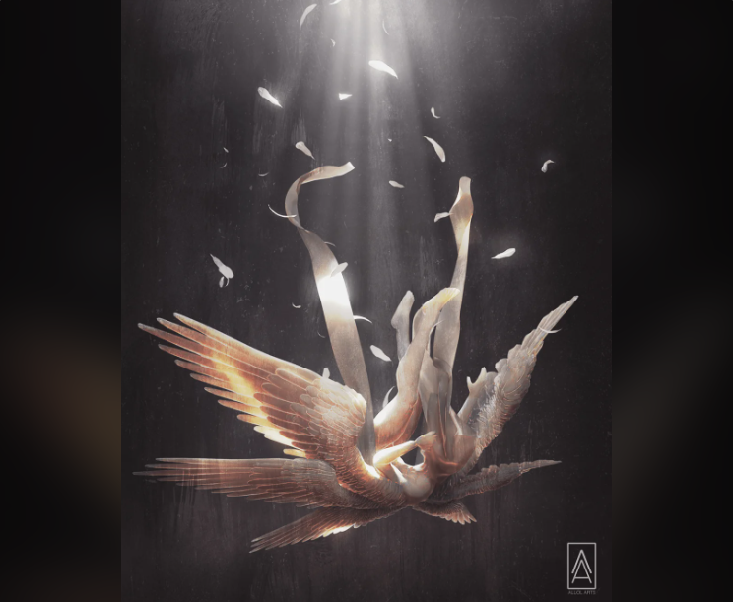
1) After Satan’s initial sin that we see here, he was cast away from his place in heaven at God’s throne. However, he still had access to God. We see this in Job 1:6-12.
2) In the book of Revelation during the Tribulation, Satan was cast from heaven and restricted to the Earth (Revelation 12:7-13).
3) At the beginning of the 1,000-year Millennium, Satan will be cast into a bottomless pit (Revelation 20:1-3).
4) After the Millennium, Satan will be briefly released but then after he is defeated, he will be cast into the Lake of Fire for forever (Revelation 20:10).
Notes:
https://www.reddit.com/r/Art/comments/vln6un/lucifers_fall_me_3ddigital_2022/

Slide 49
Isaiah 14:12-15
How you have fallen from heaven,
You star of the morning, son of the dawn!
You have been cut down to the earth,
You who defeated the nations!
13 But you said in your heart,
‘I will ascend to heaven;
I will raise my throne above the stars of God,
And I will sit on the mount of assembly in the recesses of the north.
14 I will ascend above the heights of the clouds;
I will make myself like the Most High.’
15 Nevertheless you will be brought down to Sheol,
To the recesses of the pit.

Slide 50
I will ascend to heaven
Romans 12:15
Rejoice with those who rejoice

Slide 51
I will ascend to heaven
I will raise my throne above the stars of God
Revelation 1:20
As for the mystery of the seven stars which you saw in My right hand, and the seven golden lampstands: the seven stars are the angels of the seven churches, and the seven lampstands are the seven churches.
1 Peter 5:6
Therefore humble yourselves under the mighty hand of God, so that He may exalt you at the proper time...

Slide 52
I will ascend to heaven
I will raise my throne above the stars of God
I will sit on the mount of assembly in the recesses of the north
Psalm 48:2-3
Beautiful in elevation, the joy of the whole earth, is Mount Zion in the far north, In its palaces, God has made Himself known as a stronghold.
Jeremiah 45:5
But as for you, are you seeking great things for yourself? Do not seek them…

Slide 53
I will ascend to heaven
I will raise my throne above the stars of God
I will sit on the mount of assembly in the recesses of the north
I will ascend above the heights of the clouds
Colossians 3:12
Therefore, as God’s chosen people, holy and dearly loved, clothe yourselves with compassion, kindness, humility, gentleness and patience

Slide 54
I will ascend to heaven
I will raise my throne above the stars of God
I will sit on the mount of assembly in the recesses of the north
I will ascend above the heights of the clouds
I will make myself like the Most High
James 4:6
But He gives a greater grace. Therefore it says, “God is opposed to the proud, but gives grace to the humble.

Slide 55
Poor in spirit
Those who mourn
The gentle
Those who hunger and thirst for righteousness
The merciful
The pure in heart
The peacemakers
Those who have been persecuted for the sake of righteousness
When people insult you and persecute you, and falsely say all kinds of evil against you because of Me

Slide 56
Genesis 3:5
For God knows that on the day you eat from it your eyes will be opened, and you will become like God, knowing good and evil.

Slide 57
Why is there evil and why do we suffer?
Mankind starting with Adam and Eve

Slide 58
Man (Adam) was connected to the ground (Adamah) | Genesis 2:7: Then the Lord God formed the man of dust from the ground, and breathed into his nostrils the breath of life; and the man became a living person.
Man was connected to God | Genesis 1:26: Then God said, “Let Us make mankind in Our image, according to Our likeness…”
Man was connected to other creatures | Genesis 2:19: And out of the ground the Lord God formed every animal of the field and every bird of the sky, and brought them to the man to see what he would call them; and whatever the man called a living creature, that was its name.
Man was connected to other people | Genesis 2:21-23: So the Lord God caused a deep sleep to fall upon the man, and he slept; then He took one of his ribs and closed up the flesh at that place. 22 And the Lord God fashioned into a woman the rib which He had taken from the man, and brought her to the man. 23 Then the man said, “At last this is bone of my bones, And flesh of my flesh; She shall be called ‘woman,’ Because she was taken out of man.”
Man was connected to himself | Genesis 2:25: And the man and his wife were both naked, but they were not ashamed.
Man was connected to his purpose | Genesis 2:15: Then the Lord God took the man and put him in the Garden of Eden to cultivate it and tend it.
Man was connected to the domain that God gave him | Genesis 1:18: God blessed them; and God said to them, “Be fruitful and multiply, and fill the earth, and subdue it; and rule over the fish of the sea and over the birds of the sky and over every living thing that moves on the earth.”

Slide 59
We are separated from the ground. | Genesis 3:17, “Cursed is the ground because of you; with hard labor you shall eat from it all the days of your life.” Work is hard. We have famines, floods, earthquakes, hurricanes.
We are separated from God. | Whereas God once walked among us in the Garden, now He has become our judge.
We are separated from community. | We have isolation and loneliness. We compete with our neighbors rather than cooperate with them. We are suspicious and fearful of others.
We are separated from each other. | We become murders: Cain killed Abel. It is estimated that in the twentieth century alone, 108 million people have been killed in wars. Though it is impossible to know, it is estimated that in all of human history over 1 billion people have been killed in war. This does not include murder, rape, thief, and other crimes against each other.
We are separated from authority. | We refuse to be humble and admit wrong. We blame others. We justify our words or actions. We make excuses. We think that we are always right because no one else tells us what to do.
We are separated from ourselves. | We are broken emotionally. We are broken physically. We are broken spiritually. We are broken psychologically. We have shame, guilt, confusion, anxiety, and self-loathing. Our thinking is wrong. We are suspicious of God’s motives towards us. When we sin and know that it is wrong, we oftentimes justify it rather than humbly repent of it.
We are separated from our God created purpose. | We now refuse to bow before God. We would rather serve ourselves than to serve God. We have made ourselves as the judge and arbitrator of what is true and good.
We are separated from the dominion that God originally gave to us. | Instead of ruling over nature we are destroying it. We pollute. We cause extinctions. We are sadistic.
We are separated from eternal life. | Rather than the assurance of being with God forever; we are condemned to eternal judgment in Hell.

Slide 60
Don’t believe God | “You certainly will not die!”
God is withholding good from you | “For God knows that on the day you eat from it your eyes will be opened”
You can rise up from the position that God has put you in | “you will become like God”
Only good will come from your rebellion | “knowing good and evil.”

Slide 61
Sin | Genesis 3:6 (Adam & Eve being tempted to take from the tree of the knowledge of good and evil) | Luke 4:2-12 (Jesus being tempted by Satan) | 1 John 2:1 (Christians tempted in general)
Pleasure/ Physical Appetite | Good for food | Tell this stone to become bread | Lust of the flesh
Greed | Delight to the eyes | I will give You all this domain and its glory | Lust of the eyes
Pride | Desirable to make one wise | If You are the Son of God, throw Yourself down from here | Boastful pride of life

Slide 62
Otherwise, we think that pain, suffering, sickness, and death are normal.
2) We blame God for the horrors that are in the world rather than blaming ourselves.
3) Jesus came primarily as a good teacher and as an example.

Slide 63
What are the sources of suffering?
There are four sources of suffering:
God
The Devil
Ourselves
A broken world

Slide 64
What are the sources of suffering?
The action of God
The judgment is directly from God
Genesis 3:24 So He drove the man out…
Genesis 13:10 the Lord destroyed Sodom and Gomorrah

Slide 65
The action of God
The judgment is directly from God
The judgment is through human agents

Slide 66
The action of God
The judgment is directly from God
The judgment is through human agents
The judgment is the natural consequence of the laws of righteousness and sin that God created
Romans 1:24
Therefore God gave them up to vile impurity in the lusts of their hearts, so that their bodies would be dishonored among them.
Job 4:8
According to what I have seen, those who plow wrongdoing and those who sow trouble harvest it.

Slide 67
The action of God
The judgment is directly from God
The judgment is through human agents
The judgment is the natural consequence of the laws of righteousness and sin that God created
The final judgment at the end of the age
Revelation 20:15
And if anyone’s name was not found written in the book of life, he was thrown into the lake of fire.

Slide 68
The action of God
The judgment is directly from God
The judgment is through human agents
The judgment is the natural consequence of the laws of righteousness and sin that God created
The final judgment at the end of the age
God’s discipline of believers

Slide 69
Hebrews 12:5-6
and you have forgotten the exhortation which is addressed to you as sons, my son, do not regard lightly the discipline of the Lord, nor faint when you are punished by Him; for whom the Lord loves He disciplines, and He punishes every son whom He accepts.
1 Corinthians 11:29-30
For the one who eats and drinks, eats and drinks judgment to himself if he does not properly recognize the body. For this reason, many among you are weak and sick, and a number are asleep.

Slide 70
Job 5:17-18
17 “Behold, happy is the person whom God disciplines,
So do not reject the discipline of the Almighty.
18 For He inflicts pain, and gives relief;
He wounds, but His hands also heal.
We sin
God disciplines
God heals

Slide 71
What are the sources of suffering?
The devil can cause suffering
1 Peter 5:8-9
8 Be of sober spirit, be on the alert. Your adversary, the devil, prowls around like a roaring lion, seeking someone to devour.
9 So resist him, firm in your faith, knowing that the same experiences of suffering are being accomplished by your brothers and sisters who are in the world.

Slide 72
Scripture | Method | Examples
Genesis 3:1, “Has God really said” | Doubting what God has said. This suffering pulls us out from God’s grace and puts us into confusion. | “I’m going through a really rough patch right now. God doesn’t love me.” “God surely doesn’t want me to share the Gospel with people. I don’t think that He would want people to not like me.” “There’s plenty of people at church who can serve. There is no benefit for me to be just another helper in an already crowded field.”

Slide 73
Revelation 2:10, “Do not fear what you are about to suffer. Behold, the devil is about to throw some of you into prison” | God has people betray and lie about others. Once in prison, they are exposed to greater sin and fear. Many Christians outside of America are imprisoned for their faith. | “If only I recant my faith, then I will be able to go free.” “I’m innocent. If God truly cared about me, He wouldn’t have let this imprisonment happen.”

Slide 74
Luke 13:11, “And there was a woman who for eighteen years had had a sickness caused by a spirit; and she was bent over double, and could not straighten up at all.” | By making us sick, we are tempted to focus solely on ourselves and to turn our eyes from God. | “I’ve prayed for healing, and I’m still sick. Why bother?” “If God really loved me, I wouldn’t be sick.”

Slide 75
1 Peter 5:8, “Be of sober spirit, be on the alert. Your adversary, the devil, prowls around like a roaring lion, seeking someone to devour.” | How do lions bring down their prey? By frightening the herd and finding the one that breaks off from the pack. Then the lion devours it. | “I don’t need to go to a church building; I can get everything that I need from watching it on TV or the internet.” “Why bother getting with other Christians? They don’t care about me. They ever only talk about themselves.”

Slide 76
John 8:44, “You are of your father the devil, and you want to do the desires of your father. He was a murderer from the beginning, and does not stand in the truth because there is no truth in him. Whenever he tells a lie, he speaks from his own nature, because he is a liar and the father of lies.” | Satan will throw out lie after lie in order to deceive believers and non-believers alike. | “As long as you do your best, you’ll be OK. God loves you and will let you into heaven.” “You don’t need to be part of a church. Your inner spirituality is enough.” “The church is full of hypocrites.” Well, yes, but so is everywhere else because humans are hypocrites no matter where they are.

Slide 77
Ephesians 2:2
in which you previously walked according to the course of this world, according to the prince of the power of the air, of the spirit that is now working in the sons of disobedience.
1 John 5:19
We know that we are of God, and that the whole world lies in the power of the evil one.
2 Corinthians 4:4
in whose case the god of this world has blinded the minds of the unbelieving so that they will not see the light of the gospel of the glory of Christ, who is the image of God.

Slide 78
What are the sources of suffering?
Ourselves and other people
1) Our own disobedience and sin

Slide 79
Ourselves and other people
1) Our own disobedience and sin
2) Wrong thinking can have dire consequences
Acts 12:21-23
On an appointed day, after putting on his royal apparel, Herod took his seat on the rostrum and began delivering an address to them. 22 The people repeatedly cried out, “The voice of a god and not of a man!” 23 And immediately an angel of the Lord struck him because he did not give God the glory, and he was eaten by worms and died.

Slide 80
Ourselves and other people
1) Our own disobedience and sin
2) Wrong thinking can have dire consequences
3) The sins of others

Slide 81
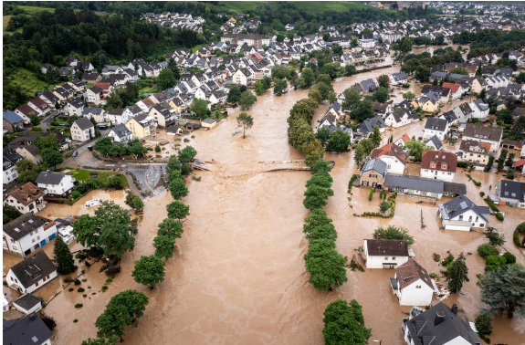
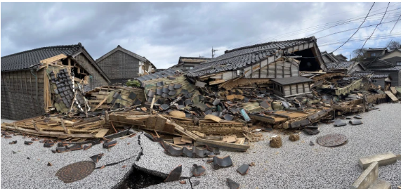
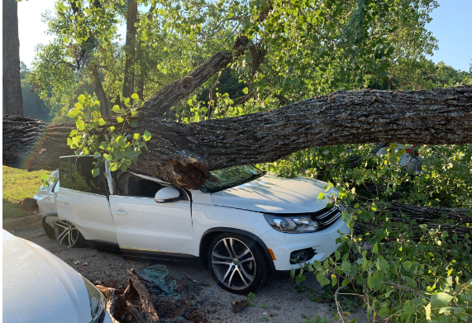
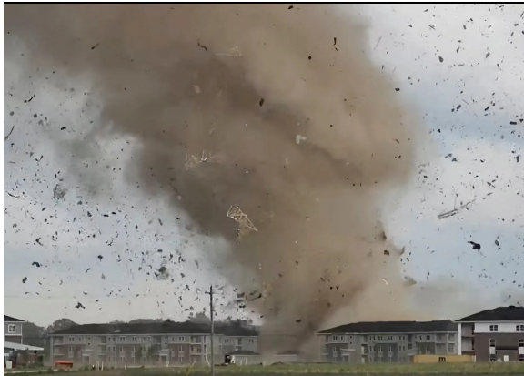
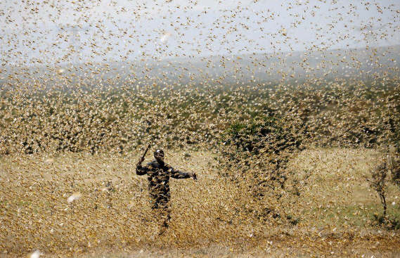
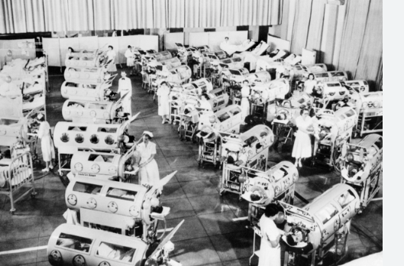
What are the sources of suffering?
A broken world

Slide 82
Wrong thinking about suffering
Wrong thinking by Christians
All suffering is a consequence of sin
Suffering is really blessing in disguise
If we only have enough faith, our suffering will go away

Slide 83
Wrong thinking about suffering
Wrong thinking by Christians
1) All suffering is a direct consequence of our sin
John 9:1-3
As Jesus passed by, He saw a man who had been blind from birth. 2 And His disciples asked Him, “Rabbi, who sinned, this man or his parents, that he would be born blind?” 3 Jesus answered, “It was neither that this man sinned, nor his parents; but it was so that the works of God might be displayed in him.”

Slide 84
Psalm 73:3-4
For I was envious of the arrogant as I saw the prosperity of the wicked. For there are no pains in their death, and their belly is fat.
Psalm 10:4-5
The wicked, in his haughtiness, does not seek Him. There is no God in all his schemes. His ways succeed at all times; yet Your judgments are on high, out of his sight; as for all his enemies, he snorts at them.

Slide 85

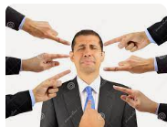
1) We become judgmental
With this way of thinking, the person suffering does not deserve compassion, rather he deserves condemnation.
Notes:
https://www.google.com/imgres?imgurl=https%3A%2F%2Fmedia.istockphoto.com%2Fid%2F598783074%2Fphoto%2Fhomeless-man-being-ignored.jpg%3Fs%3D612x612%26w%3D0%26k%3D20%26c%3DsKk-_1EKkCC8B6v3AEJJMD5pmdDwEeGv0_sG8yFgSyo%3D&tbnid=J7Iob9ZzD_nXVM&vet=12ahUKEwjwk5qJ-8yEAxUwFmIAHSpjBOUQMygLegQIARBe..i&imgrefurl=https%3A%2F%2Fwww.istockphoto.com%2Fphotos%2Fignoring-homeless&docid=2jGTApRcrA9wYM&w=612&h=358&q=ignoring%20a%20beggar&hl=en&ved=2ahUKEwjwk5qJ-8yEAxUwFmIAHSpjBOUQMygLegQIARBe

Slide 86
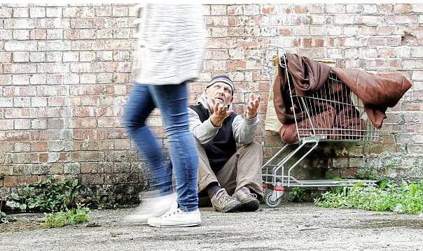
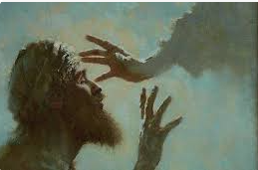
1) We become judgmental
2) We lose compassion
They deserve what they got.
Notes:
https://www.google.com/imgres?imgurl=https%3A%2F%2Fmedia.istockphoto.com%2Fid%2F598783074%2Fphoto%2Fhomeless-man-being-ignored.jpg%3Fs%3D612x612%26w%3D0%26k%3D20%26c%3DsKk-_1EKkCC8B6v3AEJJMD5pmdDwEeGv0_sG8yFgSyo%3D&tbnid=J7Iob9ZzD_nXVM&vet=12ahUKEwjwk5qJ-8yEAxUwFmIAHSpjBOUQMygLegQIARBe..i&imgrefurl=https%3A%2F%2Fwww.istockphoto.com%2Fphotos%2Fignoring-homeless&docid=2jGTApRcrA9wYM&w=612&h=358&q=ignoring%20a%20beggar&hl=en&ved=2ahUKEwjwk5qJ-8yEAxUwFmIAHSpjBOUQMygLegQIARBe

Slide 87
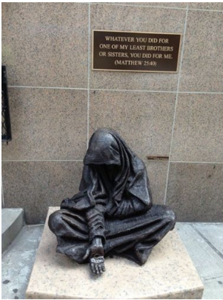

Slide 88
Psalm 106 Verses 6-12
“We have sinned”
“Rebelled”
“Gone astray”
“Behaved wickedly”
“Nevertheless He saved them”
Psalm 106 Verses 13-46
“They quickly forgot His works”
“Became lustfully greedy”
“Rebellious”
“He heard their cry”
“He also made them objects of compassion”
Psalm 107 Verses 10-16
“They had rebelled”
“He humbled their heart”
“They cried out to the Lord”
“He brought them out of darkness”
Psalm 107 Verses 17-22
“Their rebellious way”
“Their guilty deeds”
“They came close to the gates of death”
“They cried out to the Lord”
“He saved them”

Slide 89
Psalm 103:13-14
Just as a father has compassion on his children,
So the Lord has compassion on those who fear Him.
14 For He Himself knows our form;
He is mindful that we are nothing but dust.

Slide 90

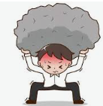
1) We become judgmental
2) We lose compassion
3) It adds to the pain of those who are suffering
Notes:
https://www.google.com/imgres?imgurl=https%3A%2F%2Fmedia.istockphoto.com%2Fid%2F598783074%2Fphoto%2Fhomeless-man-being-ignored.jpg%3Fs%3D612x612%26w%3D0%26k%3D20%26c%3DsKk-_1EKkCC8B6v3AEJJMD5pmdDwEeGv0_sG8yFgSyo%3D&tbnid=J7Iob9ZzD_nXVM&vet=12ahUKEwjwk5qJ-8yEAxUwFmIAHSpjBOUQMygLegQIARBe..i&imgrefurl=https%3A%2F%2Fwww.istockphoto.com%2Fphotos%2Fignoring-homeless&docid=2jGTApRcrA9wYM&w=612&h=358&q=ignoring%20a%20beggar&hl=en&ved=2ahUKEwjwk5qJ-8yEAxUwFmIAHSpjBOUQMygLegQIARBe

Slide 91
1) We become judgmental
2) We lose compassion
3) It adds to the pain of those who are suffering
4) It warps our response to their suffering
Notes:
https://www.google.com/imgres?imgurl=https%3A%2F%2Fmedia.istockphoto.com%2Fid%2F598783074%2Fphoto%2Fhomeless-man-being-ignored.jpg%3Fs%3D612x612%26w%3D0%26k%3D20%26c%3DsKk-_1EKkCC8B6v3AEJJMD5pmdDwEeGv0_sG8yFgSyo%3D&tbnid=J7Iob9ZzD_nXVM&vet=12ahUKEwjwk5qJ-8yEAxUwFmIAHSpjBOUQMygLegQIARBe..i&imgrefurl=https%3A%2F%2Fwww.istockphoto.com%2Fphotos%2Fignoring-homeless&docid=2jGTApRcrA9wYM&w=612&h=358&q=ignoring%20a%20beggar&hl=en&ved=2ahUKEwjwk5qJ-8yEAxUwFmIAHSpjBOUQMygLegQIARBe

Slide 92
Job 16:1-4
1 Then Job responded,
2 “I have heard many things like these;
Miserable comforters are you all!
3 Is there no end to windy words?
Or what provokes you that you answer?
4 I too could speak like you,
If only I were in your place.
I could compose words against you
And shake my head at you.”
5
  Or I could strengthen you with my mouth,
  And the condolence of my lips could lessen your pain.

Slide 93
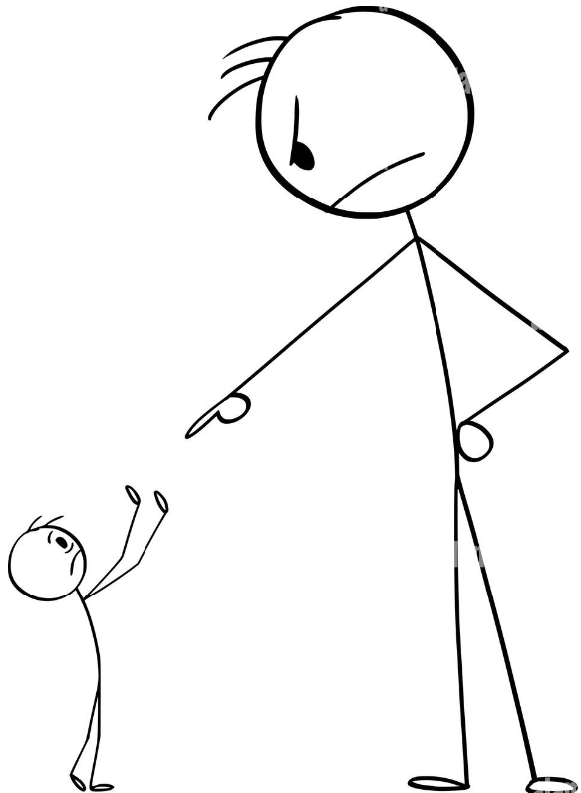
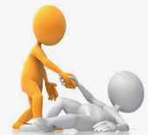
1) Wagging their fingers in his face and tearing him down
2) Strengthening him and helping to lessen his pain

Slide 94
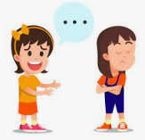
3) Ignore them

Slide 95
1) We become judgmental
2) We lose compassion
3) It adds to the pain of those who are suffering
4) It warps our response to their suffering
5) The reason for the suffering and why it continues is because of a lack of faith
Notes:
https://www.google.com/imgres?imgurl=https%3A%2F%2Fmedia.istockphoto.com%2Fid%2F598783074%2Fphoto%2Fhomeless-man-being-ignored.jpg%3Fs%3D612x612%26w%3D0%26k%3D20%26c%3DsKk-_1EKkCC8B6v3AEJJMD5pmdDwEeGv0_sG8yFgSyo%3D&tbnid=J7Iob9ZzD_nXVM&vet=12ahUKEwjwk5qJ-8yEAxUwFmIAHSpjBOUQMygLegQIARBe..i&imgrefurl=https%3A%2F%2Fwww.istockphoto.com%2Fphotos%2Fignoring-homeless&docid=2jGTApRcrA9wYM&w=612&h=358&q=ignoring%20a%20beggar&hl=en&ved=2ahUKEwjwk5qJ-8yEAxUwFmIAHSpjBOUQMygLegQIARBe

Slide 96
2 Corinthians 12:7-10
7 Because of the extraordinary greatness of the revelations, for this reason, to keep me from exalting myself, there was given to me a thorn in the flesh, a messenger of Satan to torment me—to keep me from exalting myself! 8 Concerning this I pleaded with the Lord three times that it might leave me. 9 And He has said to me, “My grace is sufficient for you, for power is perfected in weakness.” Most gladly, therefore, I will rather boast about my weaknesses, so that the power of Christ may dwell in me. 10 Therefore I delight in weaknesses, in insults, in distresses, in persecutions, in difficulties, in behalf of Christ; for when I am weak, then I am strong.

Slide 97

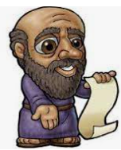
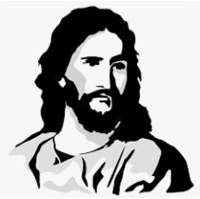

Slide 98
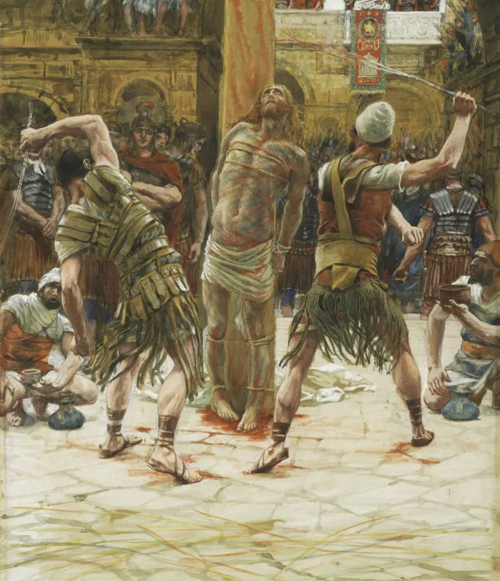

Slide 99
Wrong thinking about suffering
Wrong thinking by Christians
1) All suffering is a consequence of our sin
2) Suffering is ultimately a good thing because so much benefit can come out of it if we just allow that to happen

Slide 100
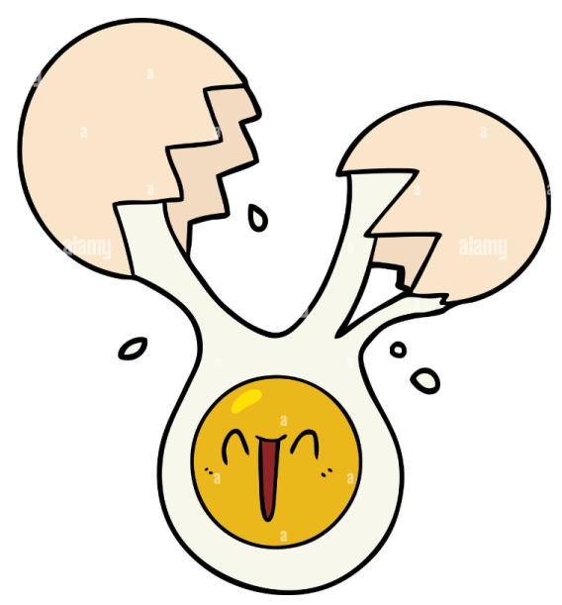
SUFFER
ING

Slide 101
2) Suffering is ultimately a good thing because so much benefit can come out of it if we just allow that to happen
a) This leads to a response of “Just look on the bright side…”
b) We take the man born blind and apply it to all suffering.
John 9:2-3
2 And His disciples asked Him, “Rabbi, who sinned, this man or his parents, that he would be born blind?” 3 Jesus answered, “It was neither that this man sinned, nor his parents; but it was so that the works of God might be displayed in him.

Slide 102
2) Suffering is ultimately a good thing because so much benefit can come out of it if we just allow that to happen
a) This leads to a response of “Just look on the bright side…”
b) We take the man born blind and apply it to all suffering.
c) This forbids people from expressing their true, legitimate feelings.

Slide 103



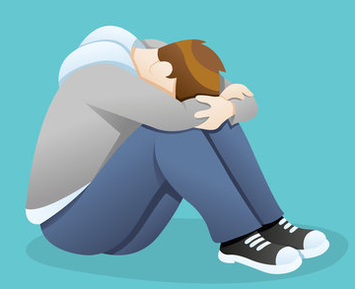
Instead

Slide 104
Psalm 130:1, “Out of the depths I have cried to You, Lord.”
Psalm 6:3, “And my soul is greatly horrified; but You, Lord—how long?”
Psalm 38:6, “I am bent over and greatly bowed down; I go in mourning all day long.”
Psalm 13:2, “How long am I to feel anxious in my soul, with grief in my heart all the day?”

Slide 105
Jesus:
In the Garden of Gethsemane Jesus said, “My soul is deeply grieved…” - Matthew 26:38
Holy Spirit:
“Do not grieve the Holy Spirit of God, by whom you were sealed for the day of redemption.” - Ephesians 4:30
“But they rebelled and grieved His Holy Spirit” – Isaiah 63:10
God the Father:
“So the Lord was sorry that He had made mankind on the earth, and He was grieved in His heart.” – Genesis 6:6

Slide 106
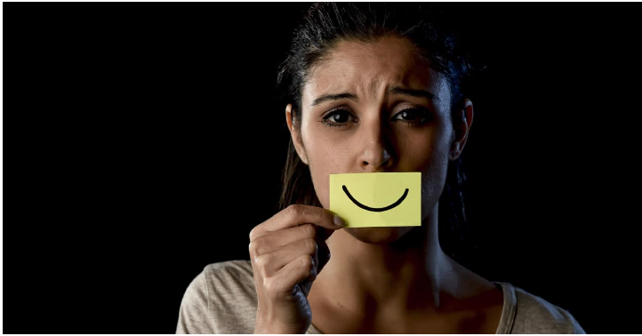

Slide 107
Romans 8:28
And we know that God causes all things to work together for good to those who love God, to those who are called according to His purpose.

Slide 108
2) Suffering is ultimately a good thing because so much benefit can come out of it if we just allow that to happen
a) This leads to a response of “Just look on the bright side…”
b) We take the man born blind and apply it to all suffering.
c) This forbids people from expressing their true, legitimate feelings.
d) We counsel that everything is OK when we should not

Slide 109
Ezekiel 13:8-11a
8 Therefore, this is what the Lord God says: “Because you have spoken deceit and have seen a lie, therefore behold, I am against you,” declares the Lord God.
9 “So My hand will be against the prophets who see false visions and utter lying divinations. They will have no place in the council of My people, nor will they be written down in the register of the house of Israel, nor will they enter the land of Israel, so that you may know that I am the Lord God.
10 It is definitely because they have misled My people by saying, ‘Peace!’ when there is no peace. And when anyone builds a wall, behold, they plaster it over with whitewash;
11 so tell those who plaster it over with whitewash, that it will fall.

Slide 110


Slide 111
Jeremiah 6:14
They have healed the brokenness of My people superficially, Saying, ‘Peace, peace,’ But there is no peace.

Slide 112
2) Suffering is ultimately a good thing because so much benefit can come out of it if we just allow that to happen
a) This leads to a response of “Just look on the bright side…”
b) We take the man born blind and apply it to all suffering.
c) This forbids people from expressing their true, legitimate feelings.
d) We counsel that everything is OK when we should not

Slide 113
2) Suffering is ultimately a good thing because so much benefit can come out of it if we just allow that to happen
a) This leads to a response of “Just look on the bright side…”
b) We take the man born blind and apply it to all suffering.
c) This forbids people from expressing their true, legitimate feelings.
d) We counsel that everything is OK when we should not
e) Forcing a reason or explanation for suffering

Slide 114
Wrong thinking about suffering
Wrong thinking by non-Christians
1) Suffering proves that there is no God

Slide 115
When we have wrong thinking about suffering, there are consequences
1) God becomes a watcher rather than an active and caring participant.
2) God is responsible for the terrible state of the world
3) Rather than be solution orientated, we become problem orientated
Numbers 14:2 And all the sons of Israel grumbled against Moses and Aaron…
Genesis 3:12 The woman whom You gave to be with me…
Genesis 2:13 The serpent deceived me…

Slide 116
When we have wrong thinking about suffering, there are consequences
1) God becomes a watcher rather than an active and caring participant.
2) God is responsible for the terrible state of the world
3) Rather than be solution orientated, we become problem orientated
4) We evaluate God’s love by our circumstances
Psalm 10:1 Why do You stand far away, Lord? Why do You hide Yourself in times of trouble?
Exodus 5:22 Then Moses returned to the Lord and said, ‘Lord, why have You brought harm to this people? Why did You ever send me?’

Slide 117
When we have wrong thinking about suffering, there are consequences
1) God becomes a watcher rather than an active and caring participant.
2) God is responsible for the terrible state of the world
3) Rather than be solution orientated, we become problem orientated
4) We evaluate God’s love by our circumstances
5) We remove God from the equation altogether

Slide 118
Lack of compassion
Being judgmental
Easy but wrong answers
Easy but wrong remedies
Denying the sufferer to grieve properly
We say “peace, peace” when there is no peace
We leave God out of the solution

Slide 119
Suffering gives us two choices
Job 2:9
Then his wife said to him,
“Do you still hold firm your integrity? Curse God and die!”
1) Hold firm to our integrity, to our faith, to our community
or
2) Curse God and die emotionally, spiritually, and socially

Slide 120
James 1:2-4
2 Consider it all joy, my brothers and sisters, when you encounter various trials,
3 knowing that the testing of your faith produces endurance.
4 And let endurance have its perfect result, so that you may be perfect and complete, lacking in nothing.

Slide 121
2 Corinthians 4:16- 18
16 Therefore we do not lose heart, but though our outer person is decaying, yet our inner person is being renewed day by day. 17 For our momentary, light affliction is producing for us an eternal weight of glory far beyond all comparison, 18 while we look not at the things which are seen, but at the things which are not seen; for the things which are seen are temporal, but the things which are not seen are eternal.
Decay versus Renewal
Momentary versus Eternal
Light Affliction versus Weight of Glory
Seen versus Not Seen
Temporal versus Eternal

Slide 122
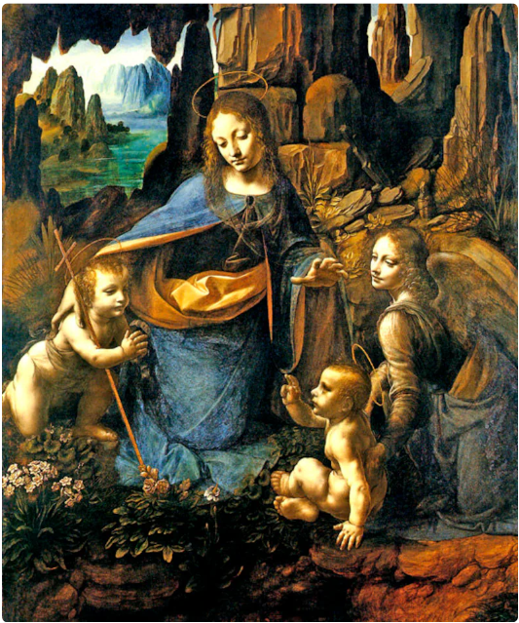
Deuteronomy 30:15
See, I have placed before you today life and happiness, and death and adversity…

Slide 123
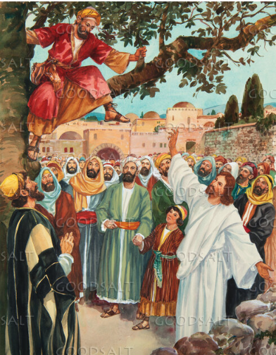
Jesus can relate to our pain because He has experienced it Himself
Luke 19:1-5
He [Jesus] entered Jericho and was passing through. 2 And there was a man called by the name of Zaccheus; he was a chief tax collector and he was rich. 3 Zaccheus was trying to see who Jesus was, and was unable because of the crowd, for he was small in stature. 4 So he ran on ahead and climbed up into a sycamore tree in order to see Him, for He was about to pass through that way. 5 When Jesus came to the place, He looked up and said to him, “Zaccheus, hurry and come down, for today I must stay at your house.”

Slide 124
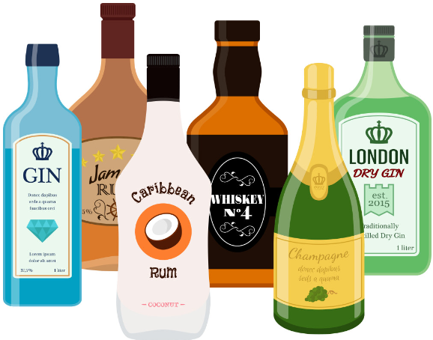

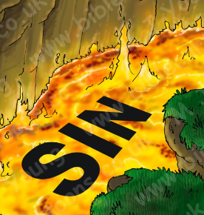


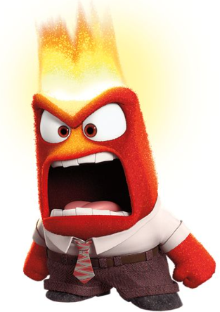

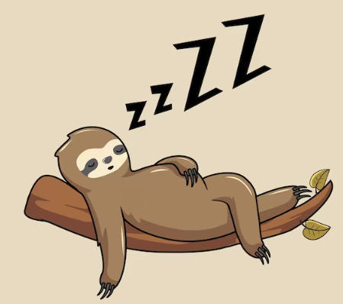

Slide 125
He became
He became a baby in a small, dusty Middle Eastern town to common parents.
He became a human and lived a life surrounded not just by sinners, but also by the lame, the sick, the blind, the oppressed, the poor. And He did not just see these terrible sufferings, He experienced much of it.
He became the Man of Sorrows.
He became our sin.
He became the Lamb of God, slaughtered, that we might be brought to God.

Slide 126
Hebrews 4:15-16
¹⁵For we do not have a high priest who cannot sympathize with our weaknesses, but One who has been tempted in all things as we are, yet without sin.
¹⁶Therefore let us draw near with confidence to the throne of grace, so that we may receive mercy and find grace to help in time of need.

Slide 127
Loneliness: Matthew 26:46, “About the ninth hour Jesus cried out with a loud voice, saying," ELI, ELI, LAMA SABACHTHANI?" that is, "MY GOD, MY GOD, WHY HAVE YOU FORSAKEN ME?”
Temptation: Matthew 4:1, “Then Jesus was led up by the Spirit into the wilderness to be tempted by the devil.”
Death of close relative/friend: Matthew 14:11-13, “And his head was brought on a platter and given to the girl, and she brought it to her mother. His disciples came and took away the body and buried it; and they went and reported to Jesus. Now when Jesus heard about John, He withdrew from there in a boat to a secluded place by Himself…”
Physical pain: Matthew 27:35, “And when they had crucified Him…”

Slide 128
Betrayal by a close friend: Matthew 26:47-48a, “While He was still speaking, behold, Judas, one of the twelve, came up accompanied by a large crowd with swords and clubs, who came from the chief priests and elders of the people. Now he who was betraying Him gave them a sign…”
Falsely accused: Matthew 26:59, “Now the chief priests and the whole Council kept trying to obtain false testimony against Jesus, so that they might put Him to death.”
Abandonment by friends: Matthew 26:71-72, “When he had gone out to the gateway, another servant-girl saw him and said to those who were there, ‘This man was with Jesus of Nazareth.’ And again he denied it with an oath, ‘I do not know the man.’"
Financial loss/homelessness: Matthew 8:20, “Jesus said to him, ‘The foxes have holes and the birds of the air have nests, but the Son of Man has nowhere to lay His head.’”

Slide 129
Isaiah 53:3-5
³He was despised and forsaken of men,
A man of sorrows and acquainted with grief;
And like one from whom men hide their face
He was despised, and we did not esteem Him.
⁴Surely our griefs He Himself bore,
And our sorrows He carried;
Yet we ourselves esteemed Him stricken,
Smitten of God, and afflicted.
⁵But He was pierced through for our transgressions,
He was crushed for our iniquities;
The chastening for our well-being fell upon Him,
And by His scourging we are healed.

Slide 130
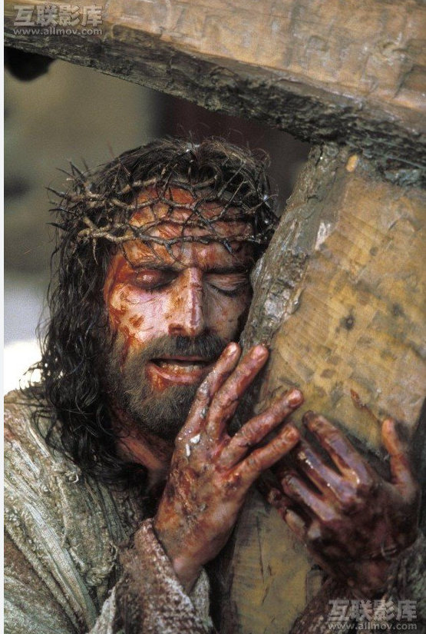
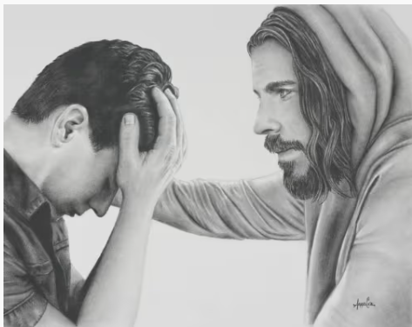
Man of Sorrows
God of all Comfort
Notes:
https://altusfineart.com/blogs/news/jesus-comforting-20-images-and-artwork

Slide 131
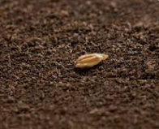







John 12:24
Truly, truly I say to you, unless a grain of wheat falls into the earth and dies, it remains alone; but if it dies, it bears much fruit.
Notes:
https://www.gcu.edu/blog/theology-ministry/theology-thursday-validating-faith-christ-through-resurrection

Slide 132
Matthew 11:28-30
28 “Come to Me, all who are weary and burdened, and I will give you rest.
29 Take My yoke upon you and learn from Me, for I am gentle and humble in heart, and you will find rest for your souls.
30 For My yoke is comfortable, and My burden is light.”

Slide 133

How should we respond to our own suffering?
1) Solidify your spiritual foundation
1) We read and study our Bible

Slide 134




Slide 135


How should we respond to our own suffering?
1) Solidify your spiritual foundation
1) We read and study our Bible
2) Attend church

Slide 136
Bride – Ephesians 5:22-23
Jesus’ body – Ephesians 1:23
Flock – Acts 20:28
Household of God – 1 Timothy 3:15

Slide 137
Hebrews 10:24-25
24 and let’s consider how to encourage one another in love and good deeds, 25 not abandoning our own meeting together, as is the habit of some people, but encouraging one another; and all the more as you see the day drawing near.

Slide 138



How should we respond to our own suffering?
1) Solidify your spiritual foundation
1) We read and study our Bible
2) Attend church
3) Prayer

Slide 139
Philippians 4:6-7
6 Be anxious for nothing, but in everything by prayer and supplication with thanksgiving let your requests be made known to God. 7 And the peace of God, which surpasses all comprehension, will guard your hearts and your minds in Christ Jesus.

Slide 140

How should we respond to our own suffering?
2) Acknowledge your feelings

Slide 141
“On Death and Dying”
We Deny – An inability to comprehend the loss
We are Angry – “This shouldn’t have happened.”
We Bargain – “If only…”
Depression – Realization and sadness
Acceptance – We start to heal

Slide 142


Slide 143


Is this you?

Slide 144
Psalm 6:2-3a
Be gracious to me, Lord, for I am frail; heal me, Lord, for my bones are horrified. And my soul is greatly horrified; but You, Lord—how long?
6 I am weary with my sighing; every night I make my bed swim, I flood my couch with my tears.

Slide 145
Psalm 25:16-18
16 Turn to me and be gracious to me, for I am lonely and afflicted.
17 The troubles of my heart are enlarged; bring me out of my distresses.
18 Look at my misery and my trouble, and forgive all my sins.

Slide 146
Psalm 42:5
Why are you in despair, my soul? And why are you restless within me?
Psalm 44:24-25
Why do You hide Your face and forget our affliction and oppression? For our souls have sunk down into the dust; our bodies cling to the earth.

Slide 147


Slide 148
Psalm 55:17
Evening and morning and at noon, I will complain and murmur,
And He will hear my voice.

Slide 149

How should we respond to our own suffering?
3) Maintain your routines

Slide 150
How should we respond to our own suffering?
4) Find joy
Notes:
https://www.facebook.com/wordfindersclub/photos/a.1137224779706610/4201416326620758/?type=3

Slide 151


Notes:
https://www.google.com/imgres?imgurl=https%3A%2F%2Fi.pinimg.com%2Foriginals%2F7e%2F73%2Fd7%2F7e73d7ec2eb27440d80fd30c8fd3172c.jpg&tbnid=HZAzN0RTHmV1kM&vet=12ahUKEwjlmoT_07uFAxUQI2IAHeIgBGMQxiAoCXoECAAQNA..i&imgrefurl=https%3A%2F%2Fwww.pinterest.com%2Fpin%2F201254677080066897%2F&docid=Qo-IHOz1jn6pGM&w=1200&h=1642&itg=1&q=mild%20mannered%20clark%20kent&ved=2ahUKEwjlmoT_07uFAxUQI2IAHeIgBGMQxiAoCXoECAAQNA
https://en.wikipedia.org/wiki/Superman

Slide 152
If Scripture is, as evangelicals and their theology have affirmed throughout history, the very word of our almighty, omniscient, and all-loving God, then the only sane choice is to let it enlighten our thinking and our actions each and every day.

Slide 153

Notes:
https://www.facebook.com/wordfindersclub/photos/a.1137224779706610/4201416326620758/?type=3

Slide 154

Notes:
https://www.ebay.com/itm/225983265093?chn=ps&_trkparms=ispr%3D1&amdata=enc%3A1ydH3qv-NR8KKEwWPjK15eQ85&norover=1&mkevt=1&mkrid=711-117182-37290-0&mkcid=2&mkscid=101&itemid=225983265093&targetid=1584571731043&device=c&mktype=pla&googleloc=9003671&poi=&campaignid=19894961968&mkgroupid=148855406073&rlsatarget=aud-1412318123216:pla-1584571731043&abcId=9307911&merchantid=111836263&gad_source=1&gclid=EAIaIQobChMIhI7Yo5zwhAMV6UxHAR39AwVqEAQYCSABEgI00PD_BwE

Slide 155


Slide 156



Slide 157
Ecclesiastes3:4
A time to weep and a time to laugh;
A time to mourn and a time to dance.

Slide 158
How should we respond to our own suffering?
5) Take your grief to God
Philippians 4:6
Do not be anxious about anything, but in everything by prayer and pleading with thanksgiving let your requests be made known to God.
Notes:
https://www.facebook.com/wordfindersclub/photos/a.1137224779706610/4201416326620758/?type=3

Slide 159
  Categories of Psalms
  Confidence/Trust
  Kingship/Royal of both God and of a human king
  Lamentation, sometimes further divided into personal and communal
  Praise hymns
  Remembrance
  Thanksgiving
  Wisdom

Slide 160
Abuse by enemies – Psalm 3
God feeling distant – Psalm 13
Sorrow – Psalm 137
Feeling overwhelmed and helpless – Psalm 69
Suffering – Psalm 22
Isolation – Psalm 102
Feeling vulnerable – Psalm 31
Guilt – Psalm 32
Feeling crushed and oppressed – Psalm 38
Betrayal – Psalm 55
A sense of injustice – Psalm 58
Envy of the wicked and rich – Psalm 73
Feeling needy – Psalm 86
Disappointment – Psalm 74
Depression/Discouragement – Psalm 88

Slide 161
Psalm 13
How long, Lord? Will You forget me forever?
How long will You hide Your face from me?
² How long am I to feel anxious in my soul,
With grief in my heart all the day?
How long will my enemy be exalted over me?
³ Consider and answer me, O Lord my God;
Enlighten my eyes, or I will sleep the sleep of death,
⁴ And my enemy will say, “I have overcome him,”
And my adversaries will rejoice when I am shaken.
⁵ But I have trusted in Your faithfulness;
My heart shall rejoice in Your salvation.
⁶ I will sing to the Lord,
Because He has looked after me.
Where are you God?
I am anxious and grieving.
I don’t know how much more I can take.
I am being judged.
Nevertheless, I trust, rejoice, and sing to You, God!

Slide 162

Psalm 22:1a
“My God, my God, why have You forsaken me?”

Slide 163
Acts 7:55-56
55 But he, being full of the Holy Spirit, looked intently into heaven and saw the glory of God, and Jesus standing at the right hand of God; 56 and he said, “Behold, I see the heavens opened and the Son of Man standing at the right hand of God.”

Slide 164

How should we respond to our own suffering?
6) Dealing with grief from the loss of a loved one
Notes:
https://www.facebook.com/wordfindersclub/photos/a.1137224779706610/4201416326620758/?type=3

Slide 165
Identity disruption (such as feeling as though part of oneself has died).
Marked sense of disbelief about the death.
Avoidance of reminders that the person is dead.
Intense emotional pain (such as anger, bitterness, sorrow) related to the death.
Difficulty with reintegration (such as problems engaging with friends, pursuing interests, planning for the future).
Emotional numbness (absence or marked reduction of emotional experience).
Feeling that life is meaningless.
Intense loneliness (feeling alone or detached from others).

Slide 166
How should we respond to our own suffering?
7) Dealing with pain
Admit your pain
Don’t let the pain control you and take over
Allow yourself moments of joy
Be active in taking back control of your life
Notes:
https://www.facebook.com/wordfindersclub/photos/a.1137224779706610/4201416326620758/?type=3

Slide 167
How should we respond to our own suffering?
8) Don’t lose sight of yourself by being a people-pleaser
We suppress our own needs, desires, expectations, feelings, and opinions.
We do this to either: gain attention, affection, validation, approval, and love or to avoid conflict, criticism, additional stress, disappointments, loss, rejection, and abandonment.
Notes:
https://www.facebook.com/wordfindersclub/photos/a.1137224779706610/4201416326620758/?type=3

Slide 168
1) We neglect ourselves.
2) Anger and resentment.
3) Your worth is defined by what other people think of you rather than what God thinks of you.
4) We become consciously or unconsciously manipulative.
5) We suppress our pain and suffering because we do not want people to feel uncomfortable around us.

Slide 169
Never take your eyes off of God because the eyes of others are more important.

Slide 170



How should we respond to our own suffering?
9) Grief and the holidays
Notes:
https://www.facebook.com/wordfindersclub/photos/a.1137224779706610/4201416326620758/?type=3

Slide 171
How should we respond to our own suffering?
10) Suicide is never the answer
This too shall pass
Notes:
https://www.facebook.com/wordfindersclub/photos/a.1137224779706610/4201416326620758/?type=3

Slide 172
2 Corinthians 4:16-18
¹⁶ Therefore we do not lose heart, but though our outer man is decaying, yet our inner man is being renewed day by day.
¹⁷ For momentary, light affliction is producing for us an eternal weight of glory far beyond all comparison,
¹⁸ while we look not at the things which are seen, but at the things which are not seen; for the things which are seen are temporal, but the things which are not seen are eternal.
2 Corinthians 4:1
Therefore, since we have this ministry, as we received mercy, we do not lose heart…

Slide 173
2 Corinthians 3:18
But we all, with unveiled face, beholding as in a mirror the glory of the Lord, are being transformed into the same image from glory to glory, just as from the Lord, the Spirit.

Slide 174
2 Corinthians 3:18,4:1
But we all, with unveiled face, beholding as in a mirror the glory of the Lord, are being transformed into the same image from glory to glory, just as from the Lord, the Spirit. Therefore, since we have this ministry, as we received mercy, we do not lose heart…
Micah 6:8
He has told you, O man, what is good; And what does the Lord require of you But to do justice, to love kindness, And to walk humbly with your God?

Slide 175
How should we respond to our own suffering?
10) Suicide is never the answer
This too shall pass
Your loss would greatly affect others
“My death does not belong to me… it’s the others who would live my death.”
Notes:
https://www.facebook.com/wordfindersclub/photos/a.1137224779706610/4201416326620758/?type=3

Slide 176
How should we respond to our own suffering?
10) Suicide is never the answer
This too shall pass
Your loss would greatly affect others
No pain, no hurt, no humiliation, no betrayal is so deep that it cannot be overcome
Notes:
https://www.facebook.com/wordfindersclub/photos/a.1137224779706610/4201416326620758/?type=3

Slide 177
Job
3:1 “May the day on which I was to be born perish…”
3:11, ““Why did I not die at birth, come out of the womb and pass away?”
3:20-21a ““Why is light given to one burdened with grief, and life to the bitter of soul, who long for death, but there is none…”
3:24-26, “For my groaning comes at the sight of my food, and my cries pour out like water. For what I fear comes upon me, and what I dread encounters me. I am not at ease, nor am I quiet, and I am not at rest, but turmoil comes.”
30:16-21, “And now my soul is poured out within me; days of misery have seized me. At night it pierces my bones within me, and my gnawing pains do not rest. By a great force my garment is distorted; it ties me up like the collar of my coat. He has thrown me into the mire, and I have become like dust and ashes. I cry out to You for help, but You do not answer me; I stand up, and You turn Your attention against me. You have become cruel to me; with the strength of Your hand You persecute me.”

Slide 178
Job 42:5
I have heard of You by the hearing of the ear; but now my eye sees You;

Slide 179
Elijah
1 Kings 19:4
Enough! Now, Lord, take my life, for I am no better than my fathers.

Slide 180
Jeremiah
Jeremiah 20:14
Cursed be the day when I was born; may the day when my mother gave birth to me not be blessed!
20:18
Why did I ever come out of the womb to look at trouble and sorrow, so that my days have been spent in shame?
Jeremiah 39:18
“’For I will assuredly rescue you, and you will not fall by the sword; but you will have your own life as plunder, because you have trusted in Me,’ declares the Lord.”

Slide 181
David
13:1-2
How long, Lord? Will You forget me forever? How long will You hide Your face from me? How long am I to feel anxious in my soul, with grief in my heart all the day?
18:4-5
The ropes of death encompassed me, and the torrents of destruction terrified me. The ropes of Sheol surrounded me; the snares of death confronted me.
42:5
Why are you in despair, my soul? And why are you restless within me?
145:21
My mouth will speak the praise of the Lord, and all flesh will bless His holy name forever and ever

Slide 182
Moses
Numbers 11:14-15
I am not able to carry all this people by myself, because it is too burdensome for me. 15 So if You are going to deal with me this way, please kill me now, if I have found favor in Your sight, and do not let me see my misery.

Slide 183
Hebrews 11:24-29
24 By faith Moses, when he had grown up, refused to be called the son of Pharaoh’s daughter,
25 choosing rather to endure ill-treatment with the people of God than to enjoy the temporary pleasures of sin,
Moses chose ill-treatment, inconvenience, and sacrifice rather than sin.
26 considering the reproach of Christ greater riches than the treasures of Egypt; for he was looking to the reward.
Moses fixed his eyes on the eternal: the reward.
27 By faith he left Egypt, not fearing the wrath of the king; for he persevered, as though seeing Him who is unseen.
Moses persevered by looking to God. He chose the eternal yet unseen over the momentary and immediate.
28 By faith he kept the Passover and the sprinkling of the blood, so that the destroyer of the firstborn would not touch them.
Moses obeyed God.
29 By faith they passed through the Red Sea as through dry land; and the Egyptians, when they attempted it, were drowned.
Moses followed God’s leading no matter how scary it seemed.

Slide 184


Charles H. Spurgeon

Slide 185
“the sympathy of Jesus is the next most precious thing to his sacrifice.”
“This morning, being myself more than usually compassed with infirmities, I desire to speak, as a weak and suffering preacher, of that High Priest who is full of compassion: and my longing is that any who are low in spirit, faint, despondent, and even out of the way, may take heart to approach the Lord Jesus.”
“I believe all the promises of God, but many of them I have personally tried and proved. … I would say to [fellow Christians] in their trials—My brethren, God is good. He will not forsake you: He will bear you through. … Everything else will fail, but His word never will.”

Slide 186
We persevere because there is still so much beauty in this world to experience.
We persevere because there are unborn nieces, nephews, grandchildren yet to love.
We persevere because we have unique talents to grow and share.
We persevere because there are other people who want us to live and for us to live for.
We persevere because there is something that we can create that doesn’t exist yet.
We persevere because we don’t want our story to be that we couldn’t handle it; we have a better story to tell.
We persevere because through our perseverance, we can give hope to others.
We persevere because there is great music, great books, great movies that we have yet to experience.
We persevere because we can become someone better.
We persevere because God will never leave us nor forsake us.
We persevere because God gives us hope.

Slide 187
How should we respond to our own suffering?
11) Do not dwell on the negative
Notes:
https://www.facebook.com/wordfindersclub/photos/a.1137224779706610/4201416326620758/?type=3

Slide 188
Be grateful
Gratitude reduces depression
b) Gratitude gives us greater satisfaction in life
c) Gratitude gives us a more proper self-esteem
d) Gratitude holds on to the positive longer
e) Gratitude builds stronger social relationships
f) Gratitude increases feelings of security and connectedness
g) Gratitude produces less anxiety

Slide 189
Philippians 4:11-12
I am not saying this because I am in need, for I have learned to be content whatever the circumstances. I know what it is to be in need, and I know what it is to have plenty. I have learned the secret of being content in any and every situation, whether well fed or hungry, whether living in plenty or in want.
1 Timothy 6:8
But if we have food and clothing, we will be content with that.
Hebrews 13:5
Keep your lives free from the love of money and be content with what you have, because God has said, “Never will I leave you; never will I forsake you.”

Slide 190






Keep a gratitude journal
Thank God
Thank someone
Show yourself compassion
Find meaning
Make plans

Slide 191



How should we respond to our own suffering?
12) Take care of your physical needs
Sleep
Eat well
Exercise
Notes:
https://www.facebook.com/wordfindersclub/photos/a.1137224779706610/4201416326620758/?type=3

Slide 192
How should we respond to our own suffering?
13) God’s grace will bring you through this
Corrie Ten Boom
“There is no pit so deep but He is not deeper still.”
C.S. Lewis
“Nor have I anything to offer my readers except my convictions that when pain is to be born, a little courage helps more than much knowledge, a little human sympathy more than much courage, and the least tincture of the love of God more than all.”
Notes:
https://www.facebook.com/wordfindersclub/photos/a.1137224779706610/4201416326620758/?type=3

Slide 193
Isaiah 57:15
For this is what the high and exalted One
Who lives forever, whose name is Holy, says:
“I dwell in a high and holy place,
And also with the contrite and lowly of spirit
In order to revive the spirit of the lowly
And to revive the heart of the contrite.

Slide 194
17 “If it be so, our God whom we serve is able to deliver us from the furnace of blazing fire; and He will deliver us out of your hand, O king.
18 But even if He does not, let it be known to you, O king, that we are not going to serve your gods or worship the golden image that you have set up.”

Slide 195
How should we respond to our own suffering?
14) You are not trapped by your past
2 Corinthians 5:17
Therefore if anyone is in Christ, this person is a new creation; the old things passed away; behold, new things have come.
Notes:
https://www.facebook.com/wordfindersclub/photos/a.1137224779706610/4201416326620758/?type=3

Slide 196
Philippians 3:13-14
Brothers and sisters, I do not regard myself as having taken hold of it yet; but one thing I do: forgetting what lies behind and reaching forward to what lies ahead, 14 I press on toward the goal for the prize of the upward call of God in Christ Jesus.

Slide 197


Slide 198
How should we respond to our own suffering?
15) Use your own suffering as a means to comfort others
Henri Nouwen
“Nobody escapes being wounded. We are all wounded people, whether physically, emotionally, mentally, or spiritually. The main question is not, 'How can we hide our wounds?' so we don't have to be embarrassed, but 'How can we put our woundedness in the service of others?' When our wounds cease to be a source of shame, and become a source of healing, we have become wounded healers.”
Notes:
https://www.facebook.com/wordfindersclub/photos/a.1137224779706610/4201416326620758/?type=3

Slide 199
2 Corinthians 1:3-7
3 Blessed be the God and Father of our Lord Jesus Christ, the Father of mercies and God of all comfort, 4 who comforts us in all our affliction so that we will be able to comfort those who are in any affliction with the comfort with which we ourselves are comforted by God. 5 For just as the sufferings of Christ are ours in abundance, so also our comfort is abundant through Christ. 6 But if we are afflicted, it is for your comfort and salvation; or if we are comforted, it is for your comfort, which is effective in the patient enduring of the same sufferings which we also suffer; 7 and our hope for you is firmly grounded, knowing that as you are partners in our sufferings, so also you are in our comfort.

Slide 200
God comforts us
We comfort others

Slide 201
The God and Father of our Lord Jesus Christ
The Father of mercies
The God of all comfort

Slide 202
The God and Father of our Lord Jesus Christ
“For God so loved the world that He gave His only Son…” John 3:16
This is a foundation of love and sacrifice.

Slide 203
The God and Father of our Lord Jesus Christ
The Father of mercies
Mercy is a foundation of compassion.

Slide 204
The God and Father of our Lord Jesus Christ
The Father of mercies
The God of all comfort
Comfort is healing, hope.
This is a foundation of support.

Slide 205
“So that we will be able to comfort those who are in any affliction.”
“Who comforts us in all our affliction.”
We get all from God so that we can give any to others.”

Slide 206
Isaiah 58:7-12
7 Is it not to break your bread with the hungry
And bring the homeless poor into the house;
When you see the naked, to cover him;
And not to hide yourself from your own flesh?
8 Then your light will break out like the dawn,
And your recovery will spring up quickly;
And your righteousness will go before you;
The glory of the Lord will be your rear guard.
10 And if you offer yourself to the hungry
And satisfy the need of the afflicted,
Then your light will rise in darkness,
And your gloom will become like midday.
11 And the Lord will continually guide you,
And satisfy your desire in scorched places,
And give strength to your bones;
And you will be like a watered garden,
And like a spring of water whose waters do not fail.
12 Those from among you will rebuild the ancient ruins;
You will raise up the age-old foundations;
And you will be called the repairer of the breach,
The restorer of the streets in which to dwell.

Slide 207
Stage 1 - From verses 8, 11, and 12 – The stage of suffering
We are in darkness
We are sick, wounded, in distress
We are in a scorched place
We are weak
We are dry and thirsty
We are in ruins

Slide 208
Stage 2 - From verses 7 and 10 – The stage of giving
We feed the hungry; i.e. the poor, the incapable
We give shelter to the homeless; i.e. those who have lost their way
We cover those without clothes; i.e. the vulnerable
We support and encourage the afflicted and oppressed

Slide 209
Stage 3 – From verses 8, 10, 11, 12 – The stage of resurrection
Our light will break out from the darkness
We will recover
Righteousness will go before us; i.e. we will be led down the path to think and do what is right
God will be our rear guard; i.e. God will protect us from the regrets and destruction of our past
Our gloom will be turned into warmth and light
We will be strengthened
We will be refreshed and feel like we can bear fruit again
Our lives will be rebuilt
We will no longer feel unstable and shaky, but will feel like we are standing on a solid foundation

Slide 210
2 Corinthians 7:5-7
5 For even when we came into Macedonia our flesh had no rest, but we were afflicted on every side: conflicts on the outside, fears inside. 6 But God, who comforts the discouraged, comforted us by the arrival of Titus;
7 and not only by his arrival, but also by the comfort with which he was comforted among you, as he reported to us your longing, your mourning, your zeal for me; so that I rejoiced even more.

Slide 211
How should we respond to our own suffering?
17 ) Perhaps seek professional help
Proverbs 11:14
Where there is no guidance the people fall, but in an abundance of counselors there is victory.
Notes:
https://www.facebook.com/wordfindersclub/photos/a.1137224779706610/4201416326620758/?type=3

Slide 212
How should we respond to our own suffering?
18) Realize that you are worth being victorious
Notes:
https://www.facebook.com/wordfindersclub/photos/a.1137224779706610/4201416326620758/?type=3

Slide 213
Ephesian Chapter 1
3: blessed us with every spiritual blessing in the heavenly places
4: holy and blameless
5: predestined us to adoption
6: His grace, which He freely bestowed on us
7: redemption
7: forgiveness
9: made known to us the mystery of His will
11: obtained an inheritance
12: the first to hope
13: sealed in Him with the Holy Spirit of promise
17: spirit of wisdom
18: know what is the hope of His calling
18: riches of the glory of His inheritance
19: the surpassing greatness of His power toward us

Slide 214
God is:
Holy
Forgiving
Patient
Merciful
Loving
Joyful
Kind
Faithful
Just
Creative

Slide 215
Genesis 1:27
God created man in His own image, in the image of God He created him; male and female He created them.
James 3:9
With it we bless our Lord and Father, and with it we curse men, who have been made in the likeness of God.

Slide 216
1 Peter 4:10
As each one has received a special gift, employ it in serving one another as good stewards of the manifold grace of God.

Slide 217
Colossians 2:6
Therefore as you have received Christ Jesus the Lord, so walk in Him.
Become in reality what you already are in Christ Jesus.

Slide 218
Our lowered self-image
Dull and worthless
God’s image of us
Dignity and tremendous value & worth
Our inflated self-image
Arrogant and independent
God’s image of us
Sinners who need grace and mercy

Slide 219


When we have a wrong self-image, we are trying to be how we want others to see us.
When we have a correct self-image, we see ourselves as God actually sees us.
Artificial
True

Slide 220
A wrong self-image is self’s view of self;
a right self-image is God’s view of self.

Slide 221
We are never defeated
until we give up on God.

Slide 222
Psalm 147:3
heals the brokenhearted and binds up their wounds

Slide 223
How should we respond to our other people’s suffering?
1) The importance of presence
Notes:
https://www.facebook.com/wordfindersclub/photos/a.1137224779706610/4201416326620758/?type=3

Slide 224
Job 2:11-13
11 Now when Job’s three friends heard about all this adversity that had come upon him, they came, each one from his own place—Eliphaz the Temanite, Bildad the Shuhite, and Zophar the Naamathite; and they made an appointment together to come to sympathize with him and comfort him. 12 When they looked from a distance and did not recognize him, they raised their voices and wept. And each of them tore his robe, and they threw dust over their heads toward the sky. 13 Then they sat down on the ground with him for seven days and seven nights, with no one speaking a word to him, for they saw that his pain was very great.

Slide 225
Henri Nouwen, “Out of Solitude: Three Meditations on the Christian Life”
When we honestly ask ourselves which person in our lives mean the most to us, we often find that it is those who, instead of giving advice, solutions, or cures, have chosen rather to share our pain and touch our wounds with a warm and tender hand. The friend who can be silent with us in a moment of despair or confusion, who can stay with us in an hour of grief and bereavement, who can tolerate not knowing, not curing, not healing and face with us the reality of our powerlessness, that is a friend who cares.
Compassion asks us to go where it hurts, to enter into the places of pain, to share in brokenness, fear, confusion, and anguish. Compassion challenges us to cry out with those in misery, to mourn with those who are lonely, to weep with those in tears. Compassion requires us to be weak with the weak, vulnerable with the vulnerable, and powerless with the powerless. Compassion means full immersion in the condition of being human.

Slide 226
Matthew 25:34-36
34 “Then the King will say to those on His right, ‘Come, you who are blessed of My Father, inherit the kingdom prepared for you from the foundation of the world. 35 For I was hungry, and you gave Me something to eat; I was thirsty, and you gave Me something to drink; I was a stranger, and you invited Me in; 36 naked, and you clothed Me; I was sick, and you visited Me; I was in prison, and you came to Me.’”

Slide 227
How should we respond to our other people’s suffering?
2) Acknowledge their grief
Notes:
https://www.facebook.com/wordfindersclub/photos/a.1137224779706610/4201416326620758/?type=3

Slide 228
How should we respond to our other people’s suffering?
3) Realize and allow people to grieve differently
Galatians 6:1
Brethren, even if anyone is caught in any trespass, you who are spiritual, restore such a one in a spirit of gentleness; each one looking to yourself, so that you too will not be tempted.
Notes:
https://www.facebook.com/wordfindersclub/photos/a.1137224779706610/4201416326620758/?type=3

Slide 229
Dr. Thomas Attig, “Disenfranchised Grief Revisited: Discounting Hope and Love”
“Disenfranchising messages actively discount, dismiss, disapprove, discourage, invalidate, and delegitimize the experiences and efforts of grieving. In this way, the people around the bereaved withhold permission, disallowing, constraining, hindering, and even prohibiting the survivor's mourning.”

Slide 230
How should we respond to our other people’s suffering?
4) Do not forget to pray for their current situation and not just for relief
Notes:
https://www.facebook.com/wordfindersclub/photos/a.1137224779706610/4201416326620758/?type=3

Slide 231
How should we respond to our other people’s suffering?
5) Do not judge them
Job 16:2
Miserable comforters are you all!
Job 19:2-3
How long will you torment me and crush me with words? 3 These ten times you have insulted me; you are not ashamed to wrong me.
Notes:
https://www.facebook.com/wordfindersclub/photos/a.1137224779706610/4201416326620758/?type=3

Slide 232
Psalm 34:18
The Lord is near to the brokenhearted and saves the crushed in spirit.

Slide 233

How should we respond to our other people’s suffering?
6) Bear their burdens
Galatians 6:2
bear one another’s burdens, and so fulfill the law of Christ.
Notes:
https://www.facebook.com/wordfindersclub/photos/a.1137224779706610/4201416326620758/?type=3

Slide 234



If the burden is: Disabled such as a broken bone or sick because of a severe medical treatment
Then we can:
Mow their lawn.
Cook them meals.
Run errands for them.
Drive them to appointments.
Clean the house.

Slide 235


If the burden is: Financial
Then we can:
Buy them groceries.
If applicable, pay for their medication.
Pay for utilities.

Slide 236


If the burden is: Temptation or sin
Then we can:
Be an accountability partner.
Meet with them once a week to do a Bible study on what they are struggling with.
Help that person to see that there is a better way to satisfy that need or desire than by sinning.

Slide 237


If the burden is: Grief
Then we can:
Listen. Let them talk. Let them cry. Let them rant. Let them complain.
Call them, perhaps every day if necessary. Do not text. Be personal. Let them hear you. Let them hear your concern. Do not care about what the latest pop media is saying. You are trying to comfort someone and do what is right. That style goes back thousands of years and will continue for thousands of more years long after TikTok is forgotten.

Slide 238

If the burden is: Depression
Then we can:
Recognize their pain. Do not tell them that a smile is just a frown turned upside-down. That is true if you want an artificial Christian with artificial emotions. But that is not what we want, is it? We want a healed Christian. We want a victorious Christian. We do not want a white-washed Christian.
Be available. Do not just help when it is convenient for you. They cannot schedule their suffering to coincide with when your schedule is free.
Stay in the situation until the burden is relieved.

Slide 239
Ecclesiastes 4:12
And if one can overpower him who is alone, two can resist him. A cord of three strands is not quickly torn apart.

Slide 240
Biblical examples of suffering and how they responded
Joseph
When Mary was pregnant
When they could not find a place for their child to be born
When they had to flee to Egypt
When they had lost their son returning from the census
Notes:
https://www.facebook.com/wordfindersclub/photos/a.1137224779706610/4201416326620758/?type=3

Slide 241




The top level consisted of Elites such as Imperial dynasty, Roman senatorial families, provincial officials, retired military officers, wealthy families, and some merchants. This was only about 2% of the population.
The next level down were those with moderate surplus resources which included some merchants, traders, artisans, and military veterans. This was about 7% of the population.
The next level were those at the subsistence level. These were people who had just enough to live on but no extra. These were mostly merchants, traders, shop owners, farmers, tavern owners, and wage earners. This was about 64% of the population.
The bottom level were some farmers, widows, orphans, beggars, disabled, unskilled day laborers, and prisoners. This was about 27% of the population.

Slide 242


Slide 243




1) Taxes from Rome
2) Local taxes

Slide 244


Slide 245



Areas around Nazareth

Slide 246


Slide 247


Theater of Sepphoris

Slide 248


Typical stone house in Jesus’ time

Slide 249
Mark 6:1-3
Jesus went out from there and came into His hometown; and His disciples followed Him. 2 And when the Sabbath came, He began to teach in the synagogue; and the many listeners were astonished, saying, “Where did this man learn these things, and what is this wisdom that has been given to Him, and such miracles as these performed by His hands? 3 Is this not the carpenter [tekton], the son of Mary and brother of James, Joses, Judas, and Simon? And are His sisters not here with us?” And they took offense at Him.

Slide 250
“The stone that the builders rejected has become the cornerstone?” (Luke 20:17–18)
“Upon this rock I will build My church.” (Matthew 16:18)
When passing the temple Jesus said, “Not one stone here will be left on another; every one will be thrown down.” (Mark 13:1-2).
“And he who falls on this stone will be broken to pieces; but on whomever it falls, it will scatter him like dust.” (Matthew 21:44)
We see other references to stone.
Jesus is the chief cornerstone in Matthew 21:42.
1 Peter 2:5 says, “you also, as living stones, are being built up as a spiritual house for a holy priesthood, to offer spiritual sacrifices that are acceptable to God through Jesus Christ.”

Slide 251
Joseph and the suffering of betrayal
Matthew 1:18-19
18 Now the birth of Jesus the Messiah was as follows: when His mother Mary had been betrothed to Joseph, before they came together she was found to be pregnant by the Holy Spirit. 19 And her husband Joseph, since he was a righteous man and did not want to disgrace her, planned to send her away secretly.

Slide 252


Slide 253






betrothal
processional march
wedding
new home

Slide 254
Genesis 34:8-12
8 But Hamor spoke with them, saying, “The soul of my son Shechem longs for your daughter; please give her to him in marriage. 9 And intermarry with us; give your daughters to us and take our daughters for yourselves. 10 So you will live with us, and the land shall be open to you; live and trade in it and acquire property in it.” 11 Shechem also said to her father and to her brothers, “Let me find favor in your sight, and I will give whatever you tell me. 12 Demand of me ever so much bridal payment [mohar] and gift [mattan], and I will give whatever you tell me; but give me the girl in marriage.”

Slide 255
Genesis 24:53
And the servant brought out articles of silver and articles of gold [mattan], and garments, and gave them to Rebekah; he also gave precious things [mohar] to her brother and to her mother.

Slide 256
He could have had her stoned.
Deuteronomy 22:23-24
23 If there is a girl who is a virgin betrothed to a man, and another man finds her in the city and sleeps with her, 24 then you shall bring them both out to the gate of that city and you shall stone them to death: the girl, because she did not cry out for help though she was in the city, and the man, because he has violated his neighbor’s wife. So you shall eliminate the evil from among you.

Slide 257
He could have married her anyway.

Slide 258
He could have divorced her.
Deuteronomy 24:2
“When a man takes a wife and marries her, and it happens, if she finds no favor in his eyes because he has found some indecency in her, that he writes her a certificate of divorce, puts it in her hand, and sends her away from his house…”
Go the usual process and divorce her publicly.
Divorce her privately.
Matthew 1:19
And her husband Joseph, since he was a righteous man and did not want to disgrace her, planned to send her away secretly.

Slide 259
Romans 12:18
If possible, so far as it depends on you, be at peace with all people.

Slide 260
Galatians 6:1
Brothers and sisters, even if a person is caught in any wrongdoing, you who are spiritual are to restore such a person in a spirit of gentleness; each one looking to yourself, so that you are not tempted as well.
1) “You who are spiritual”
2) “a spirit of gentleness”
3) “looking to yourself”

Slide 261
First go to him in private.
If he does not listen then go with two or three others.
If he still does not listen then take the issue before the church.
And if he still does not listen then let him be as a tax collector.

Slide 262
Joseph and the suffering of uncertainty, confusion, and hardship
Luke 2:4-7
4 Now Joseph also went up from Galilee, from the city of Nazareth, to Judea, to the city of David which is called Bethlehem, because he was of the house and family of David, 5 in order to register along with Mary, who was betrothed to him, and was pregnant. 6 While they were there, the time came for her to give birth. 7 And she gave birth to her firstborn son; and she wrapped Him in cloths, and laid Him in a manger, because there was no room for them in the inn.

Slide 263
Luke 2:1–3
Now in those days a decree went out from Caesar Augustus, that a census be taken of all the inhabited earth. 2 This was the first census taken while Quirinius was governor of Syria. 3 And all the people were on their way to register for the census, each to his own city.

Slide 264
Micah 5:2
But as for you, Bethlehem Ephrathah,
Too little to be among the clans of Judah,
From you One will come forth for Me to be ruler in Israel.
His times of coming forth are from long ago,
From the days of eternity.

Slide 265
The journey from Nazareth to Bethlehem
Finding a place to stay
Giving birth

Slide 266
Joseph and the suffering of uncertainty, confusion, and hardship
The Journey from Nazareth to Bethlehem

Slide 267


Slide 268

Joseph was an old man.
Joseph had children from a previous marriage
One of his son’s led Mary’s donkey.

Slide 269


Slide 270
Lamentations 1:9
She did not consider her future. Therefore she has fallen astonishingly…

Slide 271

Joseph and the suffering of uncertainty, confusion, and hardship
Finding a place to stay

Slide 272


No room at the inn
Jesus born in a manger

Slide 273


Stayed at a relative’s house
Jesus born in the house

Slide 274
Kataluma
Luke 22:10-12
And He [Jesus] said to them, “When you have entered the city, a man carrying a pitcher of water will meet you; follow him into the house that he enters. 11 And you shall say to the owner of the house, ‘The Teacher says to you, “Where is the guest room [kataluma] in which I may eat the Passover with My disciples?”’ 12 And he will show you a large, furnished upstairs room; prepare it there.”

Slide 275
Mark 14:14
and wherever he enters, say to the owner of the house, 'The Teacher says, "Where is My guest room [kataluma] in which I may eat the Passover with My disciples?”’

Slide 276
pandokheion
Luke 10:34-35
and came to him and bandaged up his wounds, pouring oil and wine on them; and he put him on his own animal, and brought him to an inn [pandokheion] and took care of him. 35 On the next day he took out two denarii and gave them to the innkeeper and said, ‘Take care of him; and whatever more you spend, when I return I will repay you.’

Slide 277
Luke 2:4
Now Joseph also went… to the city of David which is called Bethlehem, because he was of the house and family of David.
Luke 1:39-40
Now at this time Mary set out and went in a hurry to the hill country, to a city of Judah, and she entered the house of Zechariah and greeted Elizabeth.

Slide 278
Kenneth Bailey, a Middle Eastern and New Testament scholar
"[My] thirty-year experience with villagers in the Middle East is that the intensity of honor shown to the passing guest is still very much in force, especially when it is a returning son of the village who is seeking shelter. We have observed cases where a complete village has turned out in a great celebration to greet a young man who has suddenly arrived unannounced in the village, which his grandfather had left many years before"

Slide 279
Genesis 19:1-3
Now the two angels came to Sodom in the evening as Lot was sitting at the gate of Sodom. When Lot saw them, he stood up to meet them and bowed down with his face to the ground. 2 And he said, “Now behold, my lords, please turn aside into your servant’s house, and spend the night, and wash your feet; then you may rise early and go on your way.” They said, “No, but we shall spend the night in the public square.” 3 Yet he strongly urged them, so they turned aside to him and entered his house; and he prepared a feast for them and baked unleavened bread, and they ate.

Slide 280
Judges 19:20-21
Then the old man said, “Peace to you. Only let me take care of all your needs; however, do not spend the night in the public square.” So he took him into his house and fed the donkeys, and they washed their feet and ate and drank.

Slide 281

Exodus 18:21-22
Select out of all the people able men who fear God, men of truth, those who hate dishonest gain; and you shall place these over them as leaders of thousands, of hundreds, of fifties, and of tens. 22 Let them judge the people at all times; and let it be that they will bring to you every major matter, but they will judge every minor matter themselves. So it will be easier for you, and they will carry the burden with you.

Slide 282

Galatians 6:2
Bear one another’s burdens, and thereby fulfill the law of Christ.

Slide 283
Joseph and the suffering of uncertainty, confusion, and hardship
Mary giving birth
Luke 2:6
While they were there, the time came for her to give birth.

Slide 284

https://research.lifeway.com/2015/12/04/christmas-urban-legends-no-room-at-the-inn/

Slide 285

https://3dwarehouse.sketchup.com/model/bf06c8ce269ed73f9a41ee40a079fcc6/Israel-House-9-Archaeological-Four-Room-House-Pillared-House

Slide 286


https://biblicalisraeltours.com/2016/03/the-four-room-house/

Slide 287

https://emp.byui.edu/satterfieldb/village/village_life.htm

Slide 288

Moon-struck donkey
Smiling cow

Slide 289


Slide 290
Luke 2:16-19
16 And they came in a hurry and found their way to Mary and Joseph, and the baby as He lay in the manger. 17 When they had seen Him, they made known the statement which had been told them about this Child. 18 And all who heard it were amazed about the things which were told them by the shepherds. 19 But Mary treasured all these things, pondering them in her heart.
Verse 21
21 And when eight days were completed so that it was time for His circumcision, He was also named Jesus, the name given by the angel before He was conceived in the womb.

Slide 291

Verses 22-24
22 When the time came for the purification rites required by the Law of Moses, Joseph and Mary took him to Jerusalem to present him to the Lord 23 (as it is written in the Law of the Lord, “Every firstborn male is to be consecrated to the Lord”), 24 and to offer a sacrifice in keeping with what is said in the Law of the Lord: “a pair of doves or two young pigeons.”

Slide 292


Slide 293
Joseph and the suffering of uncertainty, confusion, and hardship
The escape to Egypt – Suffering caused by others
Matthew 2:13-15
13 Now when they had gone, behold, an angel of the Lord appeared to Joseph in a dream and said, “Get up! Take the Child and His mother and flee to Egypt, and stay there until I tell you; for Herod is going to search for the Child to kill Him.” 14 So Joseph got up and took the Child and His mother while it was still night, and left for Egypt. 15 He stayed there until the death of Herod; this happened so that what had been spoken by the Lord through the prophet would be fulfilled: “Out of Egypt I called My Son.”

Slide 294

Herod the Great

Slide 295
In 36 BC, Herod made his 17-year-old brother-in-law, Aristobulus III, high priest, because he feared that the Jews would make him their king instead of Herod. And then one year later, Herod ordered that Aristobulus III be murdered by drowning while at a party.
In 29 BC Herod thought that his wife, Mariamne I, was committing adultery. He put her on trial. Herod’s sister, Salome I and Mariamne’s mother, Alexandra, both testified against her. Mariamne was executed and Alexandra declared herself to be Queen, stating that Herod was mentally unfit to serve. Herod then executed her without trial.
In 28 BC Herod executed his brother-in-law Kostobar for conspiracy.
In 7 BC Herod accused his sons Alexander and Aristobulus of high treason and they were executed.
In 4 BC, Herod executed another son, Antipater.

Slide 296
Forgive the other person. Ephesians 4:32, “Be kind to one another, compassionate, forgiving each other, just as God in Christ also has forgiven you.”
Do not let anger or bitterness take hold of you. Hebrews 12:15, “See to it that no one comes short of the grace of God; that no root of bitterness springing up causes trouble, and by it many become defiled;”
Seek advice from others. Proverbs 11:14, “Where there is no guidance the people fall, but in an abundance of counselors there is victory.”
Bless that person, if possible, as hard as that might be. Romans 12:20-21, “’But if your enemy is hungry, feed him; if he is thirsty, give him a drink; for in so doing you will heap burning coals on his head.’ Do not be overcome by evil, but overcome evil with good.”
Pray for them. Matthew 5:44, “But I say to you, love your enemies and pray for those who persecute you…”

Slide 297
Joseph and the suffering of uncertainty, confusion, and hardship
When Joseph lost Jesus on his way back from the census

Slide 298
Luke 2:39-51
39 And when His parents had completed everything in accordance with the Law of the Lord, they returned to Galilee, to their own city of Nazareth. 40 Now the Child continued to grow and to become strong, increasing in wisdom; and the favor of God was upon Him. 41 His parents went to Jerusalem every year at the Feast of the Passover. 42 And when He was twelve years old, they went up there according to the custom of the feast; 43 and as they were returning, after spending the full number of days required, the boy Jesus stayed behind in Jerusalem, but His parents were unaware of it.

Slide 299
44 Instead, they thought that He was somewhere in the caravan, and they went a day’s journey; and then they began looking for Him among their relatives and acquaintances. 45 And when they did not find Him, they returned to Jerusalem, looking for Him. 46 Then, after three days they found Him in the temple, sitting in the midst of the teachers, both listening to them and asking them questions. 47 And all who heard Him were amazed at His understanding and His answers. 48 When Joseph and Mary saw Him, they were bewildered; and His mother said to Him, “Son, why have You treated us this way? Behold, Your father and I have been anxiously looking for You!”

Slide 300
49 And He said to them, “Why is it that you were looking for Me? Did you not know that I had to be in My Father’s house?” 50 And yet they on their part did not understand the statement which He had made to them. 51 And He went down with them and came to Nazareth, and He continued to be subject to them; and His mother treasured all these things in her heart.

Slide 301
John 1:46
Nathanael said to him, “Can anything good be from Nazareth?”
Isaiah 11:1
Then a shoot will spring from the stem of Jesse, and a Branch from his roots will bear fruit.
Matthew 2:23
and came and settled in a city called Nazareth. This happened so that what was spoken through the prophets would be fulfilled: ‘He will be called a Nazarene.

Slide 302
39 And when His parents had completed everything in accordance with the Law of the Lord, they returned to Galilee, to their own city of Nazareth.
41 His parents went to Jerusalem every year at the Feast of the Passover.
1) They “completed.”
2) “completed everything in accordance with the Law of the Lord.”

Slide 303
Leviticus 12:1-4
When a woman gives birth and delivers a male child, then she shall be unclean for seven days; as she is in the days of her menstruation, she shall be unclean. 3 Then on the eighth day the flesh of his foreskin shall be circumcised. 4 And she shall stay at home in her condition of blood purification for thirty-three days; she shall not touch any consecrated thing, nor enter the sanctuary until the days of her purification are completed.

Slide 304
39 And when His parents had completed everything in accordance with the Law of the Lord, they returned to Galilee, to their own city of Nazareth.
41 His parents went to Jerusalem every year at the Feast of the Passover.
1) They “completed.”
2) “completed everything in accordance with the Law of the Lord.”
3) They went “every year” to Jerusalem for the Passover.

Slide 305


Slide 306

“a sword will pierce your own soul.”

Slide 307

“in the temple, sitting in the midst of the teachers, both listening to them and asking them questions.”
“When Joseph and Mary saw Him, they were bewildered; and His mother said to Him, ‘Son, why have You treated us this way? Behold, Your father and I have been anxiously looking for You!’”

Slide 308
The book of Lamentations
Dr. Robin Parry
“Increasingly we lack the social practices, words, and concepts necessary to grasp our pain by the horns and stare it in the face. We’ve been robbed of a vocabulary of grief and we suffer for it. The book of Lamentations accosts us by the wayside as a stranger who offers us an unasked for, unwanted and yet priceless gift. The poetry of pain. We would be wise to pay attention.”

Slide 309
Chapter 1 | 22 verses
Chapter 2 | 22 verses
Chapter 3 | 66 verses
Chapter 4 | 22 verses
Chapter 5 | 22 verses

Slide 310

Hebrew alphabet – 22 letters

Slide 311



Slide 312


Slide 313


Slide 314


Slide 315


Slide 316


Slide 317
There were defeats on three levels.
The first level was a military defeat.
The second level was a political defeat.
The third level was a spiritual defeat.

Slide 318

1 How lonely sits the city

Slide 319


That once had many people!

Slide 320

She has become like a widow
Notes:
https://www.saatchiart.com/art/Painting-The-Widow/816155/3700461/view

Slide 321
Who was once great among the nations!
She who was a princess among the provinces
Has become a forced laborer!
2 She weeps bitterly in the night,
And her tears are on her cheeks;
She has no one to comfort her

Slide 322


She who was a princess among the provinces
Has become a forced laborer!

Slide 323


Slide 324


Slide 325


Slide 326


Slide 327





19 You, O Lord, rule forever;
Your throne is from generation to generation.
20 Why do You forget us forever?
Why do You forsake us so long?

Slide 328
John Swinton
“By learning the practice of lament, we become the type of people who take seriously the pain and sadness of the world but refuse to be crushed by it.”

Slide 329








Slide 330
Kaizen = “good change” or “continuous improvement”
1) Eliminate waste
2) Encourage purpose
3) Pressing forward

Slide 331
1) Let go of assumptions and trying to understand why
2) Be proactive
3) Do not be paralyzed trying to have everything be perfect
4) Allow others to help
5) Maintain a sense of value and worth

Slide 332
2 Corinthians 12:9
My grace is sufficient for you, for power is perfected in weakness.

Slide 333
Lamentations 3:21-26
21 I recall this to my mind, therefore I wait.
22 The Lord’s acts of mercy indeed do not end, for His compassions do not fail.
23 They are new every morning; great is Your faithfulness.
24 “The Lord is my portion,” says my soul, “Therefore I wait for Him.”
25 The Lord is good to those who await Him, to the person who seeks Him.
26 It is good that he waits silently for the salvation of the Lord.

Slide 334
“acts of mercy” | Because maybe some of this is the result of our sin or that we have sinned in trying to deal with it.
“compassions” | Because at this moment perhaps more than any other in our Christian life, we need God’s attention. We need Him to relate to us, to sympathize with our weaknesses, to know that we are frail and like dust. In the Hebrew, the word “compassions” comes from the word “womb.” Warm, nourishing, safe, intimate.
“new” | Because our trials can come in waves, so, too, we need God’s mercy and compassion to come at us again and again. And they never run out.
“faithfulness” | Because we do not need a God who only shows up when it is convenient for Him. We need a God who is always there. Our God is always there.
“portion” | God is our allotment. It is He that will fill us up and satisfy us. Psalm 81:10, “Open your mouth wide and I will fill it.” It is not money, fame, power, or titles that ultimately satisfy us, but God.
“good” | God is pleasant and kind to those who wait for Him. When you wait for God, at the end, you will not get a stone or a scorpion. You will get something good.
“salvation” | Deliverance comes from the Lord. Maybe that deliverance will be for our negative or self-pitying thoughts. Maybe from our anger or bitterness. Maybe it will be a physical deliverance. Maybe a healing or relief. Maybe it will be deliverance from a situation.

Slide 335


Slide 336

Song of Solomon 8:5
Who is this coming up from the wilderness, leaning on her beloved?

